Slide 1
Salesforce Integration
Integrate Salesforce with any system

Slide 2

Introduction to the course
20+Sections
100+ Lectures
Apex Rest
Apex SOAP
Chatter API
Metadata API
Platform Event, CDC, Streaming API
Assignment for practical implementations
10+ API Integrations
Live implementations with demo
Live Project
etc

Slide 3
About Author
Amit Singh ( Salesforce MVP )
Udemy Author 2+ Courses – 4.3* Udemy Rating
14X Salesforce Certified
Salesforce Architect ( 10+ Projects )
100+ Integrations completed
YouTuber @sfdc_panther
Salesforce & MuleSoft Community Leaders
Co-Organizer @ApexHours
@cloudyamit

Slide 4
Install related objects
packaging/installPackage.apexp?p0=04t2x0000048Isi

Slide 5

How to get help
Email
sfdcpanther@gmail.com
Twitter
@cloudyamit & @sfdc_panther
LinkedIn
/in/simplyamit
http://www.linkedin.com/company/sfdcpanther
4 – Question & Answer Window

Slide 6
How to Succeed with the course
Set a Major Goal
Make a Study Plan
Find a quite space
Limit Social Media
Use Related Resources
Take Breaks
Stay Healthy
Ask Questions
Reward YourSelf

Slide 7
How to access PPT & Code

Slide 8
Useful Resources

Slide 9
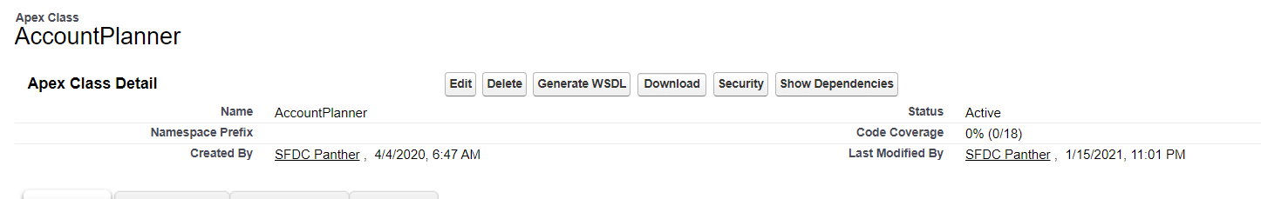
Generate WSDL from Apex Class

Slide 10
Make a Callout from Generated Apex Class
AccountPlannerService.AccountPlanner planner = new AccountPlannerService.AccountPlanner();
AccountPlannerService.SessionHeader_element element = new AccountPlannerService.SessionHeader_element();
element.sessionId = '00D2x000000EEAD!AR0AQCQo7aoByUVym6xbtsik_EeQmro38e6IoeBka9a7dkXtGwhp.qQnLIrrAVZXkxliVbxJpL7GU8oGJX0IMPWS1BmU7FB.';
planner.SessionHeader = element;
AccountPlannerService.AccountWrapper wrapper = new AccountPlannerService.AccountWrapper();
planner.createAccount(wrapper);

Slide 11
Introduction to Connected application
A connected app is a framework that enables an external application to integrate with Salesforce using APIs and standard protocols, such as SAML, OAuth, and OpenID Connect.
OR access any external system from Salesforce Using REST/SOAP API.
Connected app gives us the important information to integrate such as Client Key, Client Secret
With the connected application we can control the level of information

Slide 12
Use Cases for connected application - SFDC
Access Salesforce Data
Enable Single Sign on to your Salesforce Environment
Manage access to third party application
Provide Authorization for External API Gateways

Slide 13
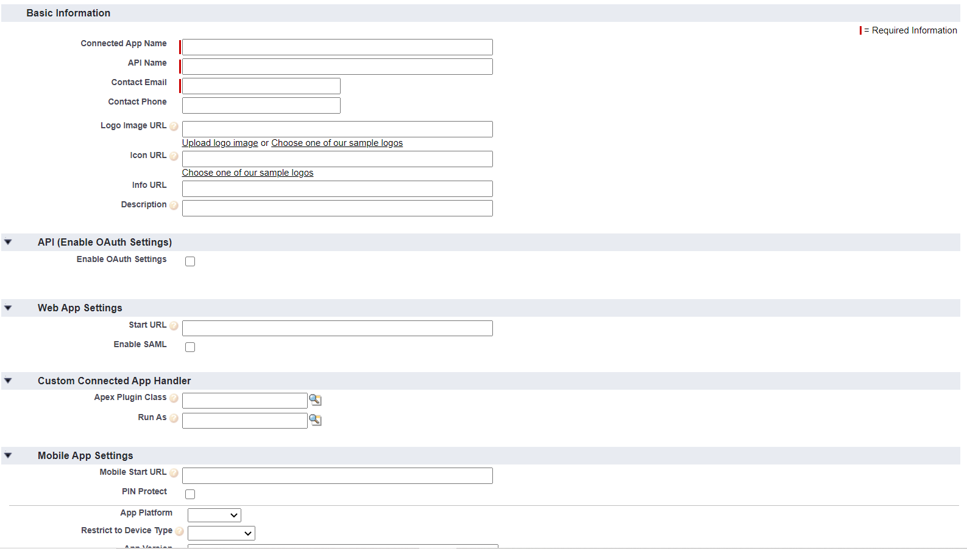
Create a Connected Application

Slide 14
Types of Authentication in Salesforce
No Authentication
API Key based authentication
Basic Authentication ( Username + Password )
OAuth 1.0
OAuth 2.0
Authorization Code Flow
Authorization Code Flow with PKCE
Implicit Flow
Resource Owner Password Credentials Flow
Client Credentials Flow
JWT Flow

Slide 15
No Authentication
If you want that the resources can be used by the public without any authentication then you should implement No Authentication.
Example => Exchange Rate API, US Population Data, IpiFy
You can get More free API from Here.

Slide 16
API Key Authentication
This is very simple and easy to use authentication. To authenticate the any system using API Key is very easy all you need to do is pass the API Key in the url parameters. Sometimes we need to pass api key as header as well.
API Key in URL - www.example.com/v1/users.json?key=hjhdbh2424hhj
API Key in Header
GET / HTTP/1.1
Host: example.com
X-API-KEY: hjhdbh2424hhj

Slide 17
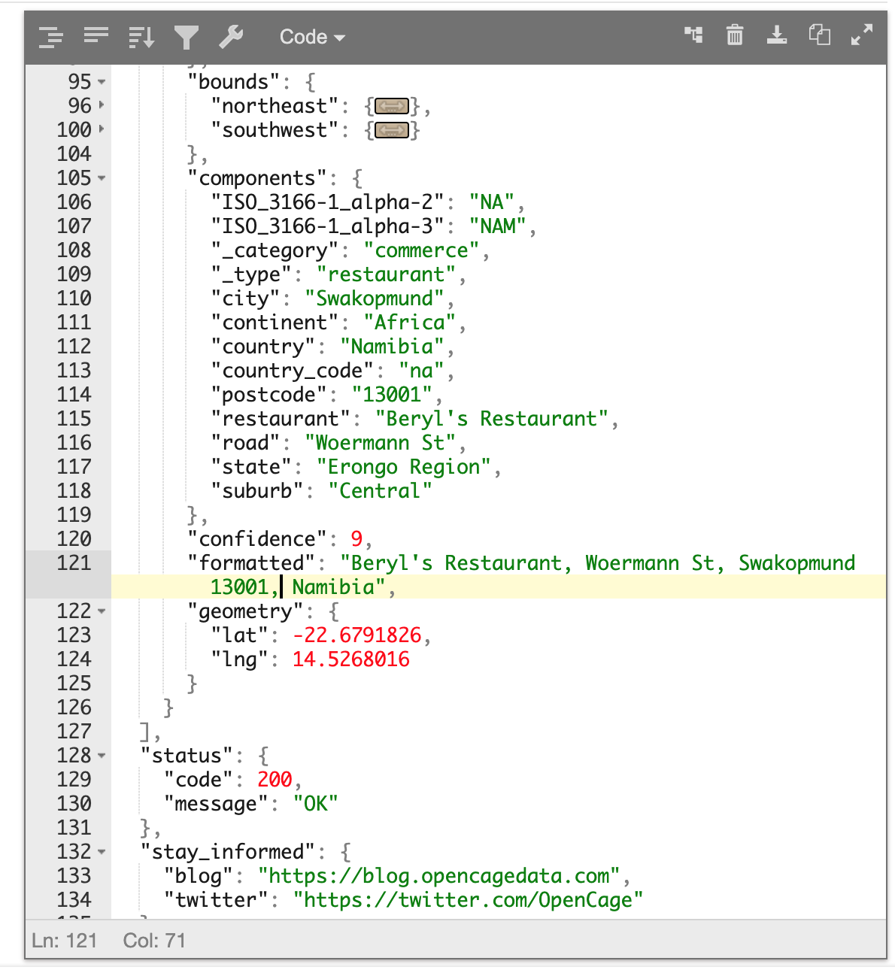
API Key Authentication
API we will integrate in this course which is using API Key authentication is OpenCage Geocoding API.
Simple api request - https://api.opencagedata.com/geocode/v1/json?q=-22.6792%2C+14.5272&key=1badb7d9b4ad4f889c54d05f6bd0b3d7&pretty=1

Slide 18
Basic Authentication
As the user ID and password are passed over the network as clear text (it is base64 encoded, but base64 is a reversible encoding), the basic authentication scheme is not secure.
HTTPS/TLS should be used with basic authentication. Without these additional security enhancements, basic authentication should not be used to protect sensitive or valuable information.
Steps
Send Base 64 Encoding - BASE64ENCODE(username:password) in header
Base64 Decoding - Base64Decode(encodedString)
Split the decoded string from :, 0 index is the username & 1 index is the password
Note: - The Step 3 is as per my understanding.

Slide 19
Introduction to OAuth 2.0 Authorization Framework
The OAuth 2.0 authorization framework is a protocol that allows a user to grant a third-party web site or application access to the user's protected resources, without necessarily revealing their long-term credentials or even their identity.
OAuth introduces an authorization layer and separates the role of the client from that of the resource owner.
In OAuth, the client requests access to resources controlled by the resource owner and hosted by the resource server and is issued a different set of credentials than those of the resource owner

Slide 20
Role in oAuth2.0
An OAuth 2.0 flow has the following roles:
Resource Owner: Entity that can grant access to a protected resource. Typically, this is the end-user.
Resource Server: Server hosting the protected resources. This is the API you want to access.
Client: Application requesting access to a protected resource on behalf of the Resource Owner.
Authorization Server: Server that authenticates the Resource Owner and issues access tokens after getting proper authorization.

Slide 21
Grant Types in oAuth 2.0
OAuth 2.0 defines four flows to get an access token. These flows are called grant types. Deciding which one is suited for your case depends mostly on your application type.
Authorization Code Flow: used by Web Apps executing on a server. This is also used by mobile apps, using the Proof Key for Code Exchange (PKCE) technique.
Implicit Flow with Form Post: used by JavaScript-centric apps (Single-Page Applications) executing on the user's browser.
Resource Owner Password Flow: used by highly-trusted apps.
Client Credentials Flow: used for machine-to-machine communication.

Slide 22
Which OAuth 2.0 Flow Should I Use?
Is the Client the Resource Owner? – Client Credentials Flow
Is the Client a web app executing on the server? - Authorization Code Flow
Is the Client absolutely trusted with user credentials? - Resource Owner Password Flow
Is the Client a Single-Page App? - Authorization Code Flow with Proof Key for Code Exchange (PKCE) and the Implicit Flow with Form Post
Is the Client a Native/Mobile App? - Authorization Code Flow with Proof Key for Code Exchange (PKCE)

Slide 23


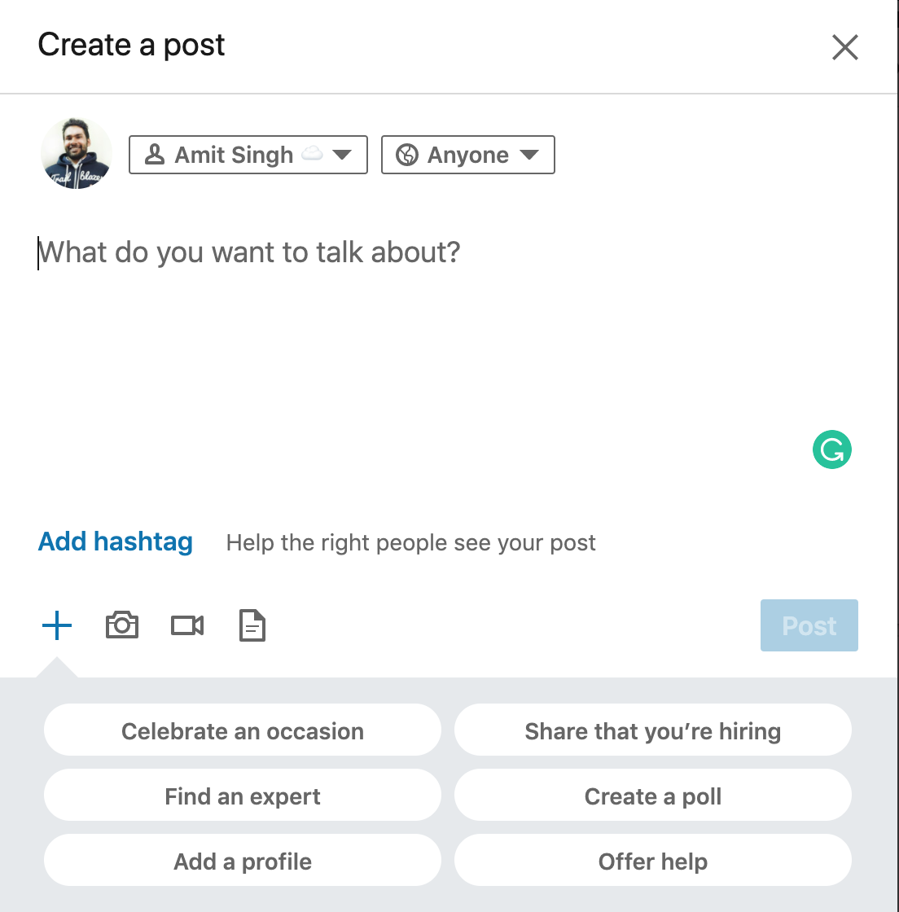
Example
usern
pass
Login
User

Slide 24
Authentication and Authorization Flows
Authorization Code Flow
Authorization Code Flow with Proof Key for Code Exchange (PKCE)
Implicit Flow with Form Post
Device Authorization Flow
Resource Owner Password Flow
Hybrid Flow
Client Credentials Flow
JWT Bearer Token Flow

Slide 25
The OAuth 1.0 Flow
The flow with the OAuth plugin is called the three-legged flow, the three primary steps involved:
Temporary Credentials Acquisition: The client gets a set of temporary credentials from the server.
Authorization: The user "authorizes" the request token to access their account.
Token Exchange: The client exchanges the short-lived temporary credentials for a long-lived token.

Slide 26
OAuth 2.0 in Action
Step 1 – Get Authorization Code
Parameters
Authorization endpoint
Response_type – code for Auth Code flow and token for implicit flow
State
Reqirect uri
Scope
Client_id

Slide 27
OAuth 2.0 in Action
Step 2 – Get Access Token
Header – Content-Type application/x-www-form-urlencoded
Parameters
Token endpoint
Code – we have got from the first step
Client_id
Client_secret
Redirect_uri
Grant_type = authorization_code

Slide 28
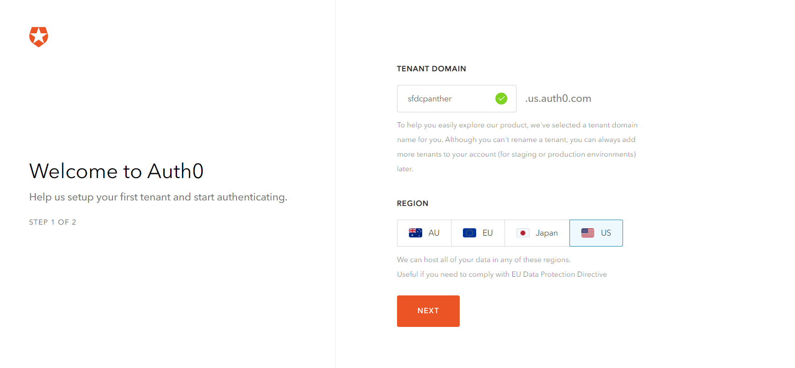
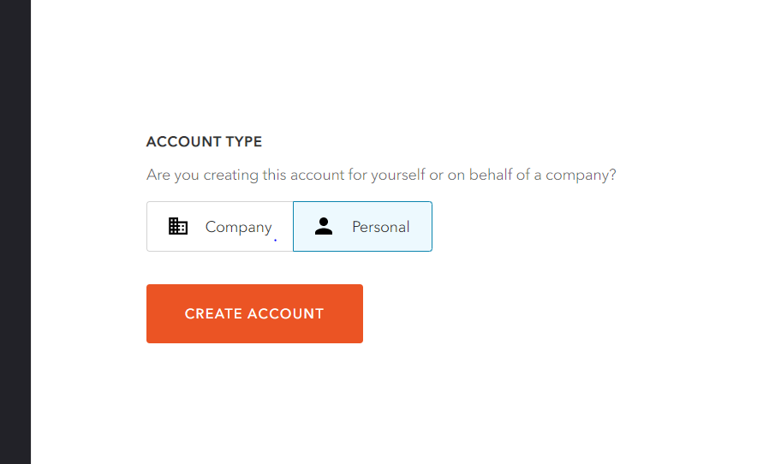
Create Auth0 account

Slide 29
OAuth 2.0 Flow ( Authorization Code Flow )
User
Web App
Auth Server
Resource Server
Clicks to login
Authorize code req to authorize
Req to Login authorization prompt
Authorize and consent
Authorization code
Code + client id + client secret
validate
Id token & access token
Req resources with token
validate
Response

Slide 30
OAuth 2.0 Flow ( Implicit Flow )
User
Application
Auth Server
Clicks to login
Credential request + response_type=token to authorize
Redirect to login authorize prompt
Authenticate & consent
Id token & Access token

Slide 31
OAuth 2.0 Flow ( Resource Owner Flow )
User
Application
Auth Server
Clicks to login
credentials + client id + client secret to oauth/token endpoint
validate
Id token & Access token

Slide 32
Sample Request
Endpoint - https://panther-udemy.us.auth0.com/oauth/token
content-type: application/x-www-form-urlencoded
Request Body –
grant_type=password
username=amit.a.panther@gmail.com
password=Udemy@2020
scope=openid profile
client_id=gUFkdzuFLwT3SwN810p364XF7y2XbQsa
client_secret=OcQqRmKvzzHr84HrEEyCl0VsvwOVy_rEsd4dM778CWbUztMYH4Zttlpv-H0kOGG4

Slide 33
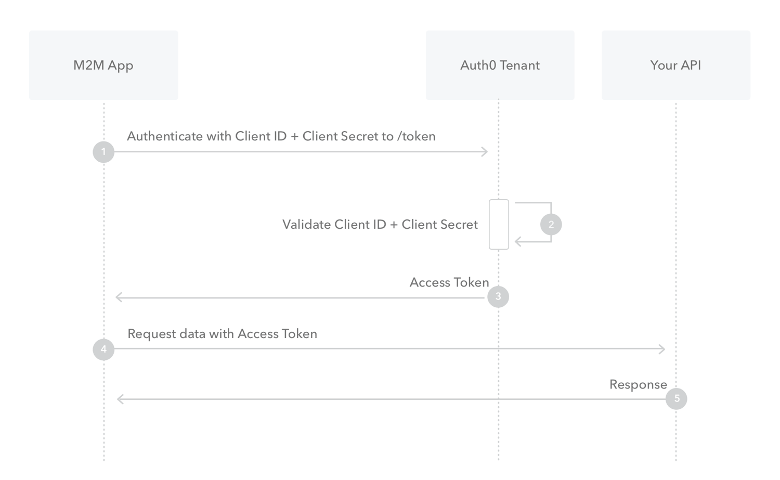
Client Credential Flow (Machine – Machine )

Slide 34
Sample Request
Token Endpoint - https://sfdcpanther.us.auth0.com/oauth/token
Method - POST
Content Type – Application/json
Body
{
"client_id": "eTTWw5Lim3kdStea40iz975uFbNx3SZa",
"client_secret": "u_WBDf1cvkJ9cGKqJW8jViqfDL8q0kG1LjsBtPN-T-i8Us_IZwcTJ04uF3u71SIC",
"audience": "https://sfdcpanther.us.auth0.com/api/v2/",
"grant_type": "client_credentials"
}

Slide 35
OAuth 2.0 Flow ( Authorization Code Flow with PKCE )
User
Web App
Auth Server
Resource Server
Clicks to login
Authorize code request + code challenge to /authorize endpoint
Request to Login authorization prompt consent
Authorize and consent
Authorization code
Authorization code + code verifier to /token endpoint
Validate code_verifier & code_challenge
Id token & access token
Req resources with token
Validate token
Response (success/error)

Slide 36
Generate code_verifier & code_challenge
code_verifier is a random string which will be sent in access token call
code_challenge is a SHA256 of code_verifier which must be base64 Url Encode.
So, here are the steps
Generate a random string and use that as code_verifier
Generate the SHA256 of this random string
Now, do the base64 Url Encode

Slide 37
Step 1 – Authorization Code
Url - https://login.salesforce.com/services/oauth2/authorize
client_id=your_client_id& grant_type=authorization_code& response_type=code& redirect_uri=your_redirect_uri& scope=openid+profile+your_scopes& code_challenge_method=S256& code_challenge=Base64UrlEncode(SHA256(code_verifier))

Slide 38
Step 2 – Access Token
Url - https://login.salesforce.com/services/oauth2/token
Method – POST
Content Type - application/x-www-form-urlencoded
grant_type=authorization_code&code_verifier=ZGQMUMyPh06FmcBtpv13Ne0jBjsV0sX2NFVropMGc5yK& code=your_authorization_code& client_id=your_client_id&
client_secret=your_secret& redirect_uri=your_redirect_uri

Slide 39
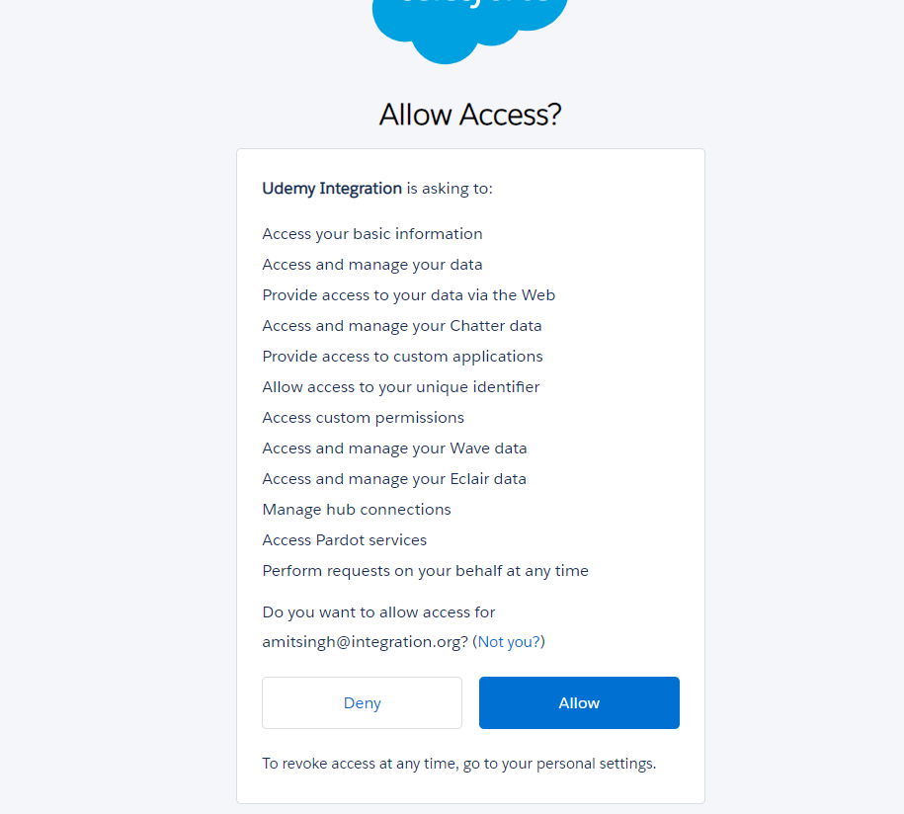

Slide 40

3rd party system included into this integration

Slide 41
3rd party system included into this integration
OpenCage Geocoder
Freshdesk
QuickBooks
Google Calendar
LinkedIn
Weather API
Financial Modeling Prep API
Tradier
NPR
Spotify
Salesforce
Box.com

Slide 42
OpenCage Geocoder
The OpenCage Geocoder provides reverse (lat/long to text) and forward (text to lat/long) geocoding via a RESTful API. Behind the scenes we query multiple geocoders from various open data sources.
Step 1 - Signup for Free OpenCage Account.
Step 2 - Get the API Key and check the Request
Step 3 - Test the API Using Browser and PostMan

Slide 43
OpenCage Geocoder
Implement OpenCage Geocoder inside Salesforce.
Steps to implement in Salesforce
Step 1 - Add Remote Site Settings
Step 2 - Create Custom Labels to Store the API Key and API Endpoint
Step 3 - Develop the Apex Code in Salesforce
Step 4 - Parse JSON response to Apex Class
Step 5 - Debug the response.

Slide 44
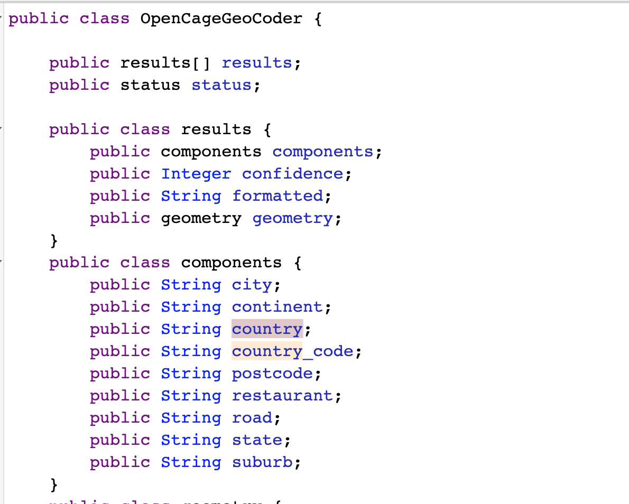
OpenCage Geocoder Assignment
Create a text Field on Account Object with Label - Full Address and API Name - Address.
Implement reverseGeoCoding method of OpenCageGeocoderUtil class to take Latitude and Longitude as query parameter and then update Full Address field with the formatter response and Shipping Address fields with the component response. Find the table for field mapping
Full Address | formatted
Shipping Street | road
Shipping State | state
Shipping City | city
Shipping Postal Code | postcode
Shipping Country | country

Slide 45
Introduction to FreshDesk
Freshdesk is a ticketing system which is used to provide the support. A Company can use Freshdesk to provide the support to their company for their issues.
Get Free Freshdesk Account
Read the API Document and go through with the Authentication api document
Test API using Postman

Slide 46
Implement Freshdesk Integration in Salesforce
Follow the below steps to implement the freshdesk integration with Salesforce
Part 1
Create a Remote Site Setting - Mandatory step for all the 3rd party apis.
Create Custom Label to Store UserName & Password
Create Contact in Freshdesk
Create Ticket in Freshdesk
Part 2
List All Tickets from Freshdesk to Salesforce
List All contacts from Freshdesk to Salesforce
List All Tickets from Freshdesk to Salesforce related to a Contact record

Slide 47
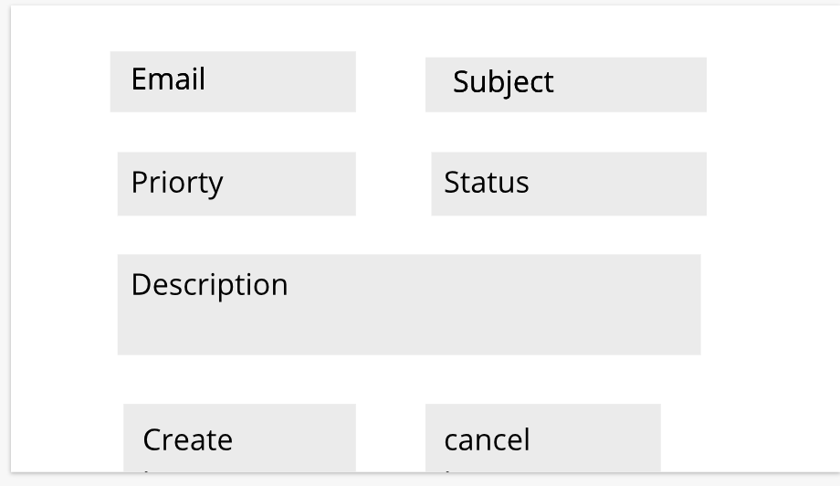
Freshdesk Assignment
As we have seen how to call the freshdesk api using apex. Now, it’s time to implement the concept that we have learned so far.
Create a custom object in salesforce Name it Freshdesk Ticket and object name should be fr_Ticket
Get the fields from this link and use the appropriate data type.
Create a field on Contact Record Label it Freshdesk Id and api name fr_id
Create a lightning aura or web component which will take the below input and when you click on save it should create the ticket in freshdesk and salesforce as well. Check the mockup

Slide 48
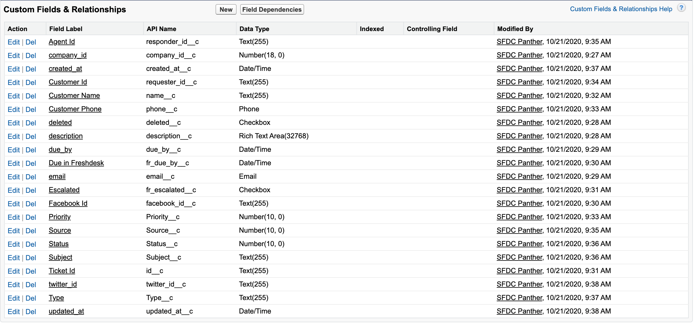
Freshdesk Ticket (fr_ticket) fields

Slide 49
Introduction to Quickbooks
Quickbooks is an accounting software which can help any small or medium size business to manage
Manage Employees & Track Expenses
Payroll & Time Tracking Management
Online Banking
There are two version of quickbooks software
a) Quickbooks Desktop (POS)
b) Quickbooks Online (QBO)

Slide 50
Setup Quickbooks Account
Get a Free 30 Days Trial Account From Here. Here is the step by step document by Quickbooks
Setup the default Sandbox for the demo purpose.
Read the authentication API and get the access token with the help of Postman
Test the sample apis using postman
Quickbooks uses oAuth 2.0 for authentication that means its uses 2 Step process to get the access token.
Step 1 - Get the authorization code
Step 2 - Get the access code
Below are the quickbooks url to make the api calls after getting the access token.
Production Base URL: https://quickbooks.api.intuit.com
Sandbox Base URL: https://sandbox-quickbooks.api.intuit.com

Slide 51
Authenticate Quickbooks from Salesforce
Add Remote Site Settings - Mandatory for all the Outbound APIs
Create a Custom Metadata to store the quickbooks access token and endpoint details
Create a VF Page and use that VF page as redirect URI
Create a custom label to store the MasterLabel of custom metadata record that we have created
Prepare the Url to get the authorization code - We did in previous Lecture
Develop and apex class to get the access token and deploy the custom metadata record.
Implement the Refresh Token method

Slide 52

Make API callouts to Quickbooks from Salesforce
We will make the below callouts from salesforce to quickbooks
Create a Customer to Quickbooks
Create an Invoice record to quickbooks related to the created contact
Create Payment record to Quickbooks

Slide 53
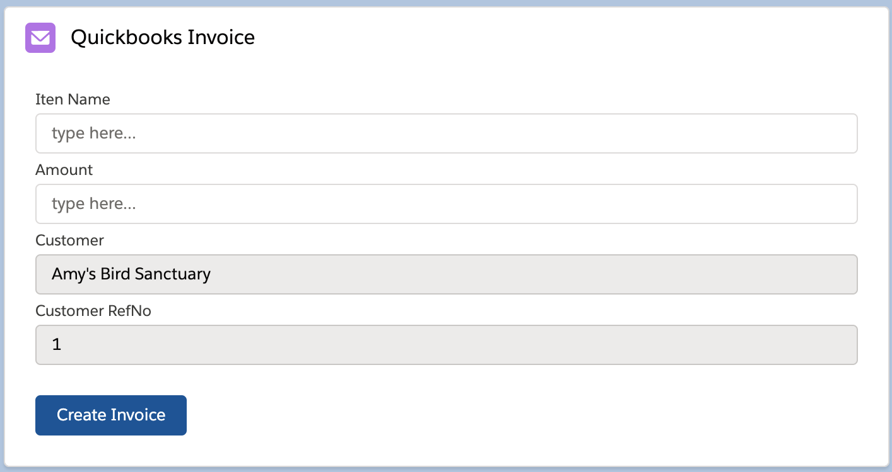
Quickbooks Assignment #1
Assignment 1 -
Create a new custom object in salesforce and Label it as Quickbooks Invoice and object name should be qb_Invoice. You can get all the fields from Here.
Create a Lightning Web/Aura Component which will take input from user to create an Invoice record into the Quickbooks system and if the Invoice is created save the invoice in salesforce system as well.
You can hard code the customer to associate the Invoice with

Slide 54
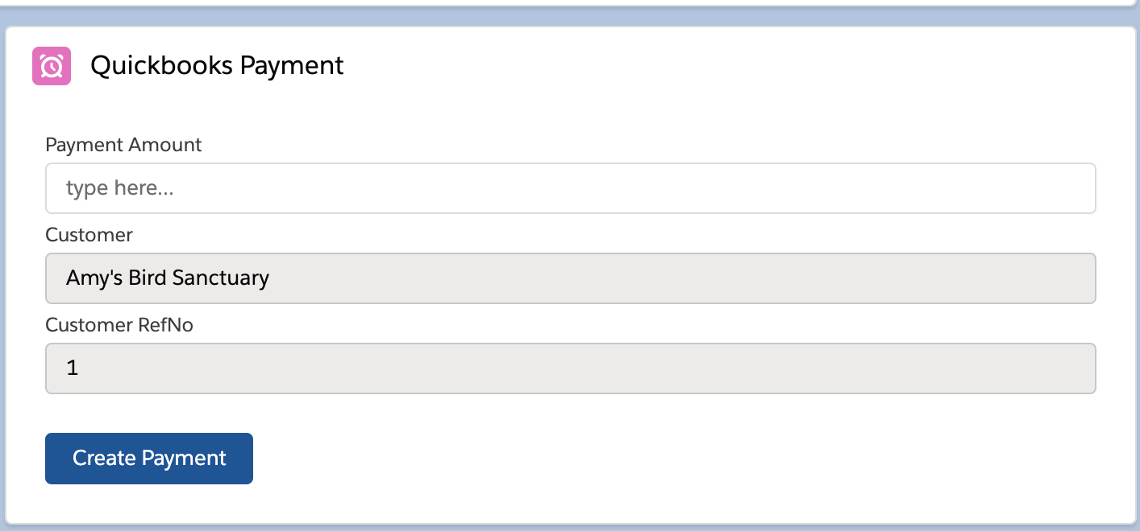
Quickbooks Assignment #2
Assignment 2 -
Create a new custom object in salesforce and Label is as Quickbooks Payment and object name should be qb_Payment. Get all the fields from Here.
Create a Lightning Web/Aura Component which will take input from user to create the Payment record into the Quickbooks system and if the Payment is created save the Payment in salesforce system as well.
You can hard code the customer to associate the payment with

Slide 55
Google Calendar Integration
Google calendar is used to create online meetings and send the invites to people.
Create VF page in salesforce
Read the API Document and find out the authentication scheme. You can get authentication document Here.
Setup connected application in Google Console
Read more about google calendar API from Here.
Know more about Google oauth scope
Create a Test Event/Calendar from Google Console

Slide 56
Test google api using Postman
Google calendar is used to create online meetings and send the invites to people.
Get the authorization code
Get the access token using PostMan
List all the events for the authenticated account.
Create a sample event using postman.

Slide 57
Authorize Google API from salesforce
Add Remote Site Setting
Create a Custom Metadata to Store Google Credentials and Other Details
Create a Custom Label to store the MasterLabel of Custom Metadata Record
Make changes into VF Page that we create into earlier lecture
Prepare the URL and get the authorization code
Get the access token and store into Metadata Object
Implement Refresh Token method
Create a new Method in Apex Class to create the Event in Google Calendar

Slide 58
Create Event in Google Calendar - Part 2
Create an Event in Salesforce Event Object
Implement an Apex Trigger to call the Apex Class Method and create the same event in Google Calendar as well.

Slide 59
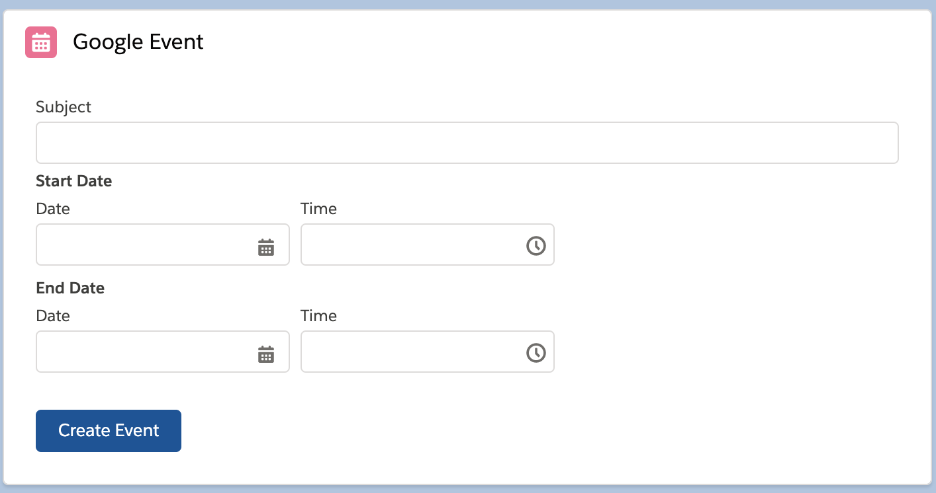
Google Assignment
Create a Lightning Web/Aura Component which will take the necessary input from the users of an Event and When user click on create Event then that event must be created in Salesforce and then into Google Calendar as well. Hint :- You only need to create the event in salesforce and rest logic will be taken care by apex trigger. Component should look like below.

Slide 60
LinkedIn Introduction
LinkedIn is a professional network where you can make your professional network for your career growth.
Create VF page in salesforce
Create a Free LinkedIn developer account using your existing LinkedIn account. Here is the link.
Read the API Document and find out the authentication scheme. You can get authentication document Here.
Setup connected application in LinkedIn developer account.
Read more about LinkedIn API from Here.

Slide 61
Authenticate LinkedIn using Salesforce
Add Remote Site Setting
Create a Custom Metadata to Store LinkedIn Credentials and Other Details
Create a Custom Label to store the MasterLabel of Custom Metadata Record
Make changes into VF Page that we create into earlier lecture
Prepare the URL and get the authorization code
Get the access token and store into Metadata Object
Implement Refresh Token method

Slide 62
Implement LinkedIn Integration with Salesforce
Get basic User details - We already have done this in our previous post.
Create a Post to LinkedIn profile using api

Slide 63
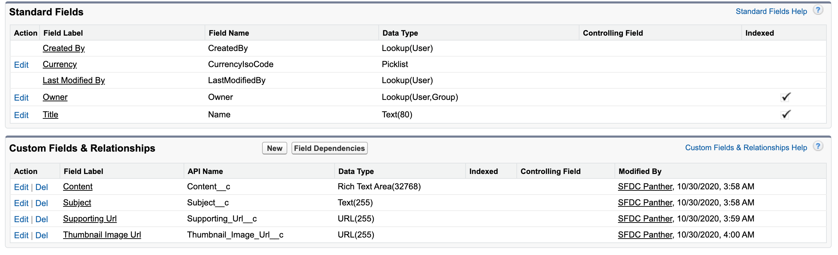
LinkedIn Assignment #1
Create a Custom object “LinkedIn Post” with the following fields.
Develop a trigger when you create any LinkedIn Post record, it should create the post in LinkedIn as well.
Find the fields below

Slide 64
LinkedIn Assignment #2
Add an additional method in LinkedInUtil class which will add the comment under the created post.
Add another method inside LinkedInUtil class which will like the created post.

Slide 65
Salesforce - Salesforce using oauth 2.0
Create a connected application in target org ( second org )
Create a vf page in integration org to use as redirect uri
Read the OAuth 2.0 document.
Create a custom metadata and store salesforce credential details of the custom metadata
Prepare the URL and get auth code using vf page.
Get the Access Token and deploy custom metadata
Implement refresh token method
Create an Account in target org.

Slide 66
Create Contact in Target Org
Create an Apex Trigger on Contact Object, when a contact created in source org then contact should get created in target org ( our second org )
FirstName
LastName
Email
Phone
Title

Slide 67
Salesforce Assignment #1
When the Lead is created in your main org ( org used in this integration ), then the same lead should be created in target org with the standard field mapped.
First Name
Last Name
Company
Title
Phone
Email
Status
Address
Description

Slide 68
Salesforce Assignment #2
Develop an Apex Rest in target org which will accept a String a parameter and as a result it will return all the case which are containing that text in subject. If the parameter is blank/null then return top 10 cases based on created date.
Hint - You can refer earlier lectures where we developed apex rest in our main org. This rest service will be developed in the target ( second org )
Now, develop a method in SalesforceUtil class which will consume that apex rest class and debug the return cases in debug log. Creating the case record would be great ( nice to have but not part of assignment. )

Slide 69
Named Credentials in Salesforce
Named credentials are use to make the API callout and simplifies the process to store the credentials in a secure way. When we used named credentials it gives the better way to handle -
Need not to create the Remote Site Setting
No need to worry about Refresh Token
Secure way to store the credentials and access token.
If we have named credentials created we can refer the same in our code like -
callout:My_Named_Credential/some_path
You can read more about named credentials from Here.

Slide 70
Implement Named credentials in Salesforce
Replace the Freshdesk implementation with Named Credentials.

Slide 71
Authentication (Auth. ) Provider in Salesforce
Auth. Providers are the external service/identity providers by which user can login to salesforce using the external credentials like Google Email, Facebook, LinkedIn, Amazon, Salesforce, Okta & etc. OR User can login to External System using their salesforce credentials.
Auth. Providers can also be used to integrate and make third party callouts from Salesforce. You can also create your own auth. provider.
Benefits of using Auth. Providers
Easy to maintain the users
Required less workforce
Can control users from one place
Can control what users can do, see
and many more

Slide 72
Google Email as Authentication Provider
Create an authentication provider from Google
Use Google to Login into salesforce with Google Auth Provider.

Slide 73
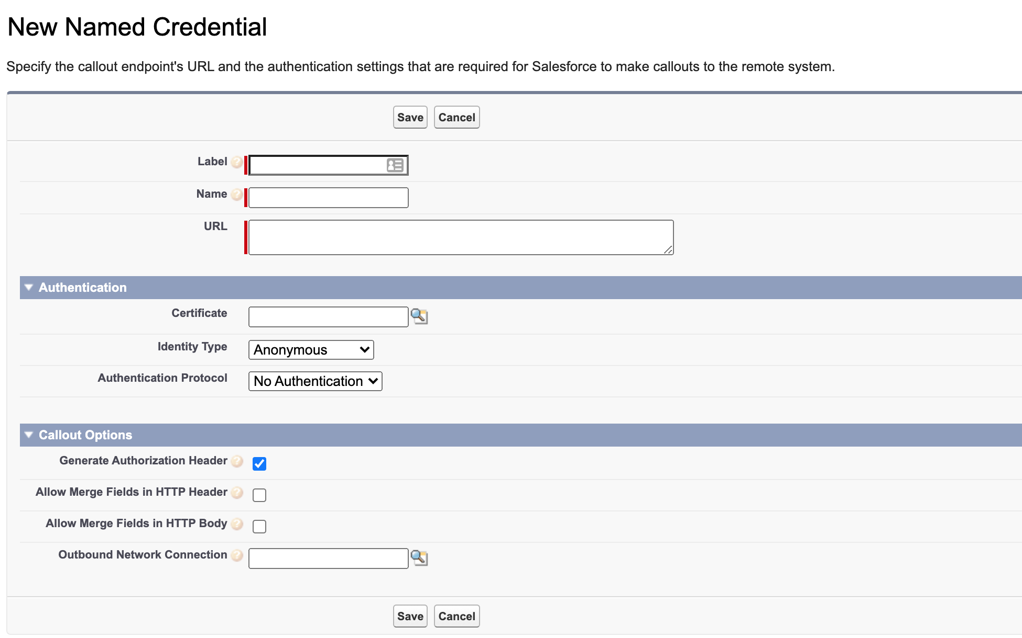
Create Named credential of Google Auth. Provider
Create a Named Credentials to use Google Email as Authentication Provider
Make an API callout to get all the Google Calendar Events

Slide 74
Auth. Provider Assignment
Create a GitHub Account if does not have already.
Read the GitHub authentication API and note down the important information like auth url, token url, base url.
Create an authentication provider in Salesforce and login using that auth. Provider in salesforce. Logged In user profile should be “Chatter Free User”
Create a Named Credential in Salesforce and Use that Named Credential to Get all the repository of your GitHub Account.

Slide 75
Salesforce Platform API
Salesforce Platform API is used to perform following operations
Extract text from image
Predict image
Sentiment Analysis
There are very few API which used JWT as authentication purpose. Below is the list of some API which uses JWT for authentication.
Salesforce
Box.com
Einstein API
We use Einstein API for this course purpose
Signup for Einstein API Services
Get the .key file and upload as a file in Salesforce Org

Slide 76
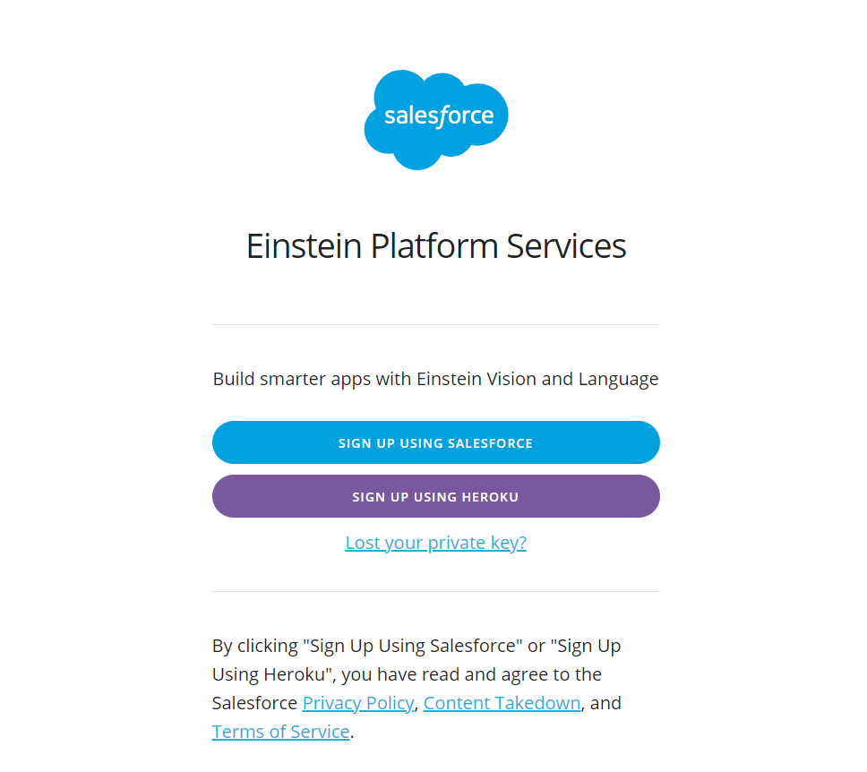
https://api.einstein.ai/signup

Slide 77
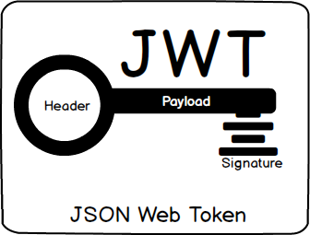
Einstein API Authentication

Slide 78
Read Text From Image using Einstein OCR

Slide 79
Assignment
Implement Einstein Prediction API
Implement Einstein Sentiment API

Slide 80
Introduction to Chatter Rest API
Build a mobile app.
Integrate a third-party web application with Salesforce so it can notify groups of users about events.
Display a feed on an external system, such as an intranet site, after users are authenticated.
Make feeds actionable and integrated with third-party sites. For example, an app that posts a Chatter item to Twitter whenever the post includes #tweet hashtag
What all operations we have included in this course.
How to get Chatter Feed using Rest API
Create a Chatter Post using API for a Record With or Without mention
Create a Chatter comment for the chatter post that we created
Send a Message to User using Chatter API & Reply to that private message.
Post Chatter to a Group
Like a post

Slide 81
Get started with Chatter API
Get my ( logged in user news feed - /services/data/v50.0/chatter/feeds/news/me/feed-elements )
Get another User feed details or Record Feed Details - /services/data/v50.0/chatter/feeds/record/0052x000000leAG/feed-elements
How to get Groups ( /services/data/v50.0/chatter/groups )
How to Group feed ( /services/data/v50.0/chatter/feeds/record/0F92x000000PrMA/feed-elements )

Slide 82
Build the Salesforce URL
Salesforce Internal/Community Instance Name - https://instance_name
The salesforce version information - /services/data/v50.0
The resource that you wanted to access - /chatter/feeds/news/me/feed-elements
Combine it all - https://instance_name/services/data/v50.0/chatter/feeds/news/me/feed-elements
If you wanted to access the information which are part of Community use below part between version information and resource. /connect/communities/communityId
The community URL is - https://instance_name/services/data/v50.0/connect/communities/communityId/chatter/feeds/news/me/feed-elements

Slide 83
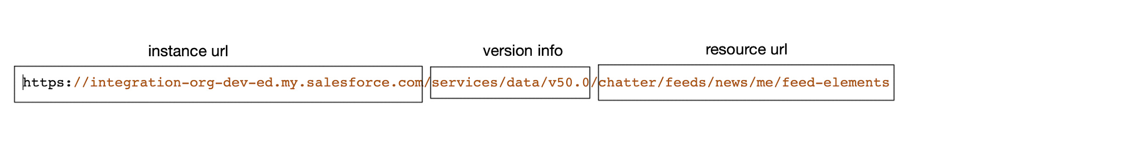
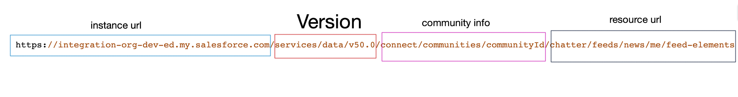
Build the Salesforce URL
Salesforce URL
Community URL

Slide 84
Create a Chatter Post using API for a Record
Create a chatter post to record without mention
Create a chatter post to record with mention
Create a post with HTML markup
Follow a record or follow a user
Get all the following details

Slide 85
Do More with chatter API
Like a chatter post
Post a Comment to a Comment in Salesforce Chatter
Send a private message to a user or group of users
Reply to that private message
Create a Chatter Group

Slide 86
Implement Chatter API using Salesforce Apex
Develop an Apex Class to make the Chatter API calls
Discuss about assignment

Slide 87
Chatter API Assignment
Delete Comment
Stop Following the record
Create a private Public Group
Request to Join a Private Group
Create a Feed Post using Apex – Create a Trigger on Contact and when any contact is created do a chatter post to that contact and mention to org salesforce admin. The text for chatter post can be any text.
Edit a ( the same that you have created ) Comment using Apex – Modify the existing Apex Trigger of Contact for after update and when the contact is updated ( any field just check last modified date ), Edit the same comment and add updated at time stap by user name. For example Update at 2020-10-10 00:30:00 by Amit Singh. Hint this might require an additional API call to get the FeedItem Id.

Slide 88
Introduction to Streaming API
Introduction
Introduction to Push Technology
Protocols for Push Technology

Slide 89
Introduction to Streaming API
Streaming API enables streaming of events using push technology and provides a subscription mechanism for receiving events in near real time. The streaming API uses push technology mechanism which involves
PushTopics Event
Generic Events
Platform Event
Change Data Capture

Slide 90
Push Technology
Push technology, also called the publish/subscribe model, transfers information that is initiated from a server to the client. This type of communication is the opposite of pull technology in which a request for information is made from a client to the server.

Slide 91
Bayeux Protocol, CometD, and Long Polling
Bayeux is a protocol for transporting asynchronous messages, primarily over HTTP.
CometD is a scalable HTTP-based event routing bus that uses an AJAX push technology pattern known as Comet. It implements the Bayeux protocol.
Long polling, also called Comet programming, allows emulation of an information push from a server to a client.
Similar to a normal poll, the client connects and requests information from the server. However, instead of sending an empty response if information isn't available, the server holds the request and waits until information is available (an event occurs).

Slide 92
Agenda
How push technology works?
Examples
Event-Driven Technology ( Publish Subscribe )
Important Terms in Push Topics
What is there in the Course for Streaming API

Slide 93




How push technology works
Push technology, or server push, is a style of Internet-based communication where the request for a given transaction is initiated by the publisher or central server. Push Technology works on publish subscribe model.
Devices
Your Service
Diffusion Server

Slide 94
Examples
Example 1 – App Notifications
Example 2 – Email Notifications
Example 3 - Messaging
Example 4 – Integrations
Example 5 – Entertainment

Slide 95
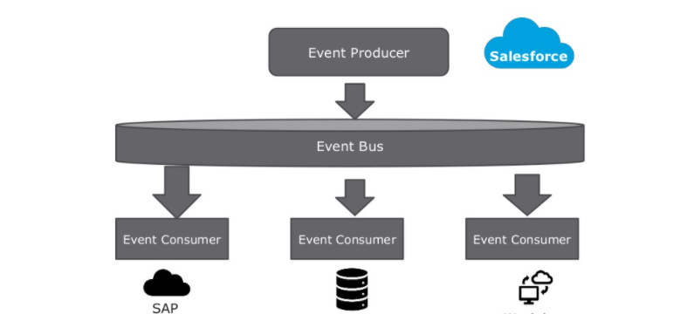
Publish Subscribe Model

Slide 96
Important Terms
Event - The creation, update, delete, or undelete of a record. Each event might trigger a notification.
Notification – A message in response to an event.
PushTopics - A PushTopic triggers notifications for changes in Salesforce records resulting from a create, update, delete, or undelete operation.
Channel - A stream of events to which a client can subscribe to receive event notifications
EventBus - A conduit in which a publisher sends an event notification. Event subscribers subscribe to a channel in the event bus to receive event notifications.
Platform Event
Change Data Capture

Slide 97
What is there in the course
How to create and subscribe push topics using workbench?
How to create push topics using apex?
How to subscribe using Lightning web component?
How to subscribe push component using node.js from outside salesforce environment.
Assignment

Slide 98
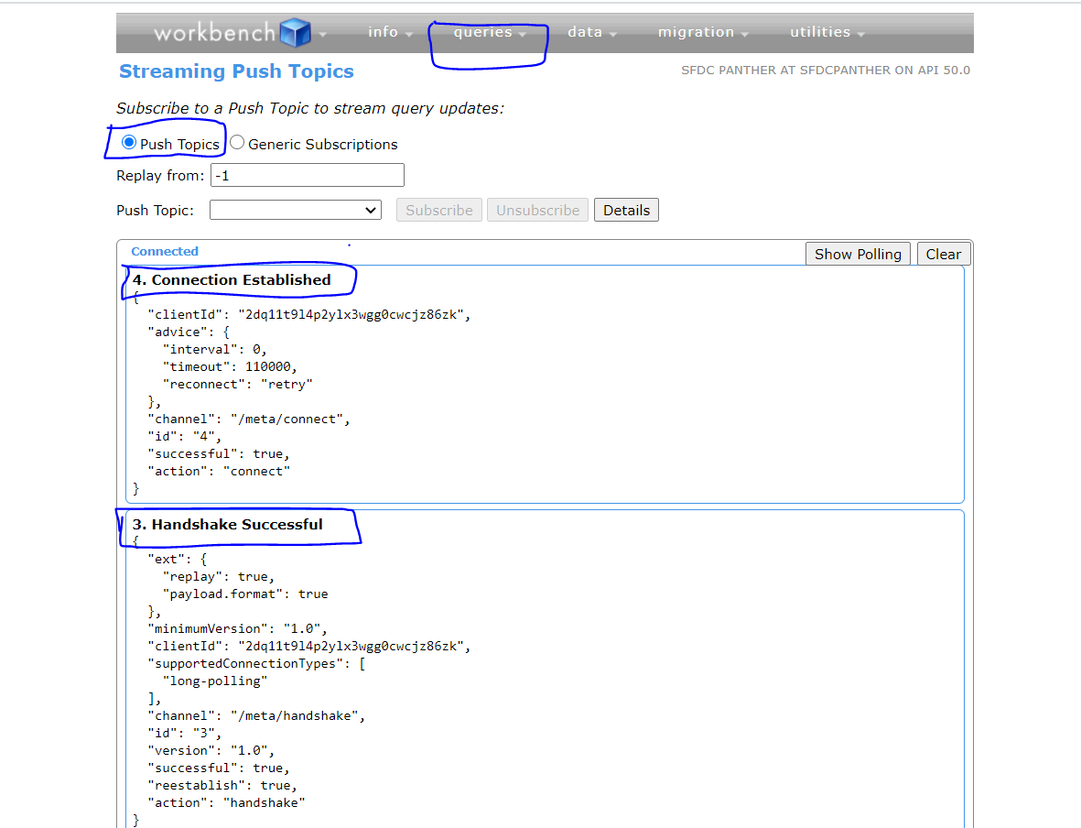
Implement Push topics using Workbench

Slide 99
Client App
Salesforce
handshake
Handshake request
Handshake successful
Subscribe
Subscribe request
Subscribe successful
Long Polling
Connect
Response
Re-Connect
Response

Slide 100
Creating Push Topic using Apex
PushTopic pushTopic = new PushTopic();
pushTopic.Name = 'InvoiceStatementUpdates';
pushTopic.Query = 'SELECT Id, Name, Status__c, Description__c FROM Invoice_Statement__c';
pushTopic.ApiVersion = 50.0;
pushTopic.NotifyForOperationCreate = true;
pushTopic.NotifyForOperationUpdate = true;
pushTopic.NotifyForOperationUndelete = true;
pushTopic.NotifyForOperationDelete = true;
pushTopic.NotifyForFields = 'Referenced';
insert pushTopic;

Slide 101
Options for NotifyForFields
All
Referenced
Select
Where

Slide 102
Subscribe Push Topic using LWC
To subscribe the push topic using Lighting or aura component we use Emp Api which is the standard module available by Salesforce.
Import the require method from lightning/EmpApi module import { subscribe, unsubscribe, onError, setDebugFlag, isEmpEnabled } from 'lightning/empApi’;
Call subscribe method to subscribe the event with the required params
Call unsubscribe method to unsubscribe the event

Slide 103
Subscribe Method
Subscribes to a given channel and returns a promise that holds a subscription object, which you use to unsubscribe later.
Subscribe( channelname, replayId, callbackMethod )
Replay Id - Indicates what point in the stream to replay events from. Specify -1 to get new events from the tip of the stream, -2 to replay from the last saved event, or a specific event replay ID to get all saved and new events after that ID.

Slide 104
Unsubscribe method
Unsubscribe( subsctiption, callback Method )

Slide 105
Subscribe Topic using Node.js
Prerequisite
Node.js installed in the system
Basic understanding of JavaScript
ES6 Concept

Slide 106
Sample Code
const jsforce = require('jsforce');
const username = 'amitsingh@integration.org';
const password = ’Password';
//const securityToken = 'YOUR_SECURITY_TOKEN';
const conn = new jsforce.Connection();
conn.login(username, password, function(err, res) {
if (err) {
return console.error(err);
}
console.log('Authenticated ', res);
conn.streaming.topic("NewAccounts").subscribe(function(message) {
console.log('Event Type : ' + message.event.type);
console.log('Event Created : ' + message.event.createdDate);
console.log('Object Id : ' + message.sobject.Id);
console.log('Event : ' + JSON.stringify(message));
});
});

Slide 107
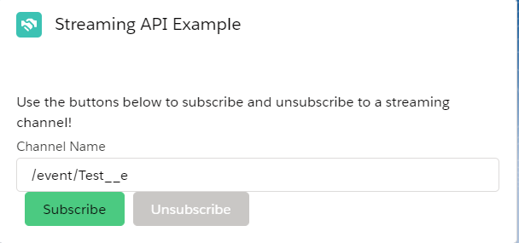
Assignment
Create a push topic which will be enabled for cases and will only broadcast Closed Cases. This Push topic must be created using apex and only send the notification if case is closed.
Create a Lightning Aura Component, use this component in home page. This component should look like what we have seen in demo.

Slide 108
Introduction to Platform Events
Use platform events to connect business processes in Salesforce and external sources through the exchange of real-time event data.
Platform events are secure and scalable.
Define fields to customize your platform event data.
Platform Events are first class Members
Platform Event works on Event Driven Architecture

Slide 109
Event Driven Architecture ( Publish subscribe )

Slide 110
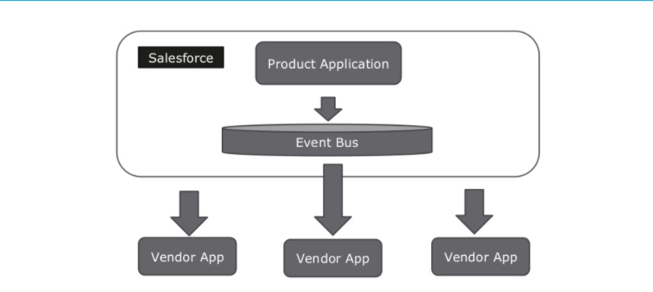
Order Management ( Salesforce to App )

Slide 111
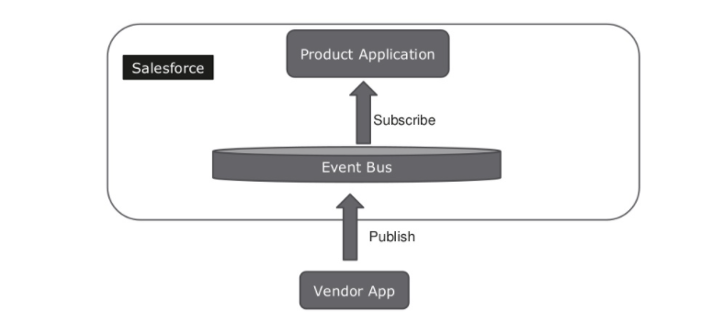
Order Management ( App to Salesforce )

Slide 112
Important Terms
Event - The creation, update, delete, or undelete of a record. Each event might trigger a notification.
Notification – A message in response to an event.
PlatformEvent - A Platform Event triggers notifications for changes in Salesforce records resulting from a create, update, delete, or undelete operation.
Channel - A stream of events to which a client can subscribe to receive event notifications
EventBus - A conduit in which a publisher sends an event notification. Event subscribers subscribe to a channel in the event bus to receive event notifications

Slide 113
Types of Platform Event
Standard Platform Events - Salesforce provides events with predefined fields, called standard platform events. An example of a standard platform event is
AssetTokenEvent, which monitors OAuth 2.0 authentication activity.
Another example is BatchApexErrorEvent, which reports errors encountered in batch Apex jobs.
High-Volume Platform Events - Use high-volume platform events to publish and process millions of events efficiently and to scale your event-based apps. Before API 45.0 Standard Events are available and after 45.0 API the custom events are High Volume be default

Slide 114
Hands-On we will perform
Create Platform Event and Publish Using Apex Class
Publish with Process Builder
Publish Event using Salesforce API
Subscribe using Lightning Aura Component
Subscribe Standard Platform Event using Lightning Aura Component
Subscribe to LogoutEventStream event using apex trigger and Component
Subscribe Platform Event using Node.js
Assignment

Slide 115
Create Your 1st Platform Event
Platform Event always ends with __e instead of __c
Platform Event can be migrated or retrieved under Custom Object
To create platform event you must need to have Customize application permission assigned to you.
Let’s do this!

Slide 116
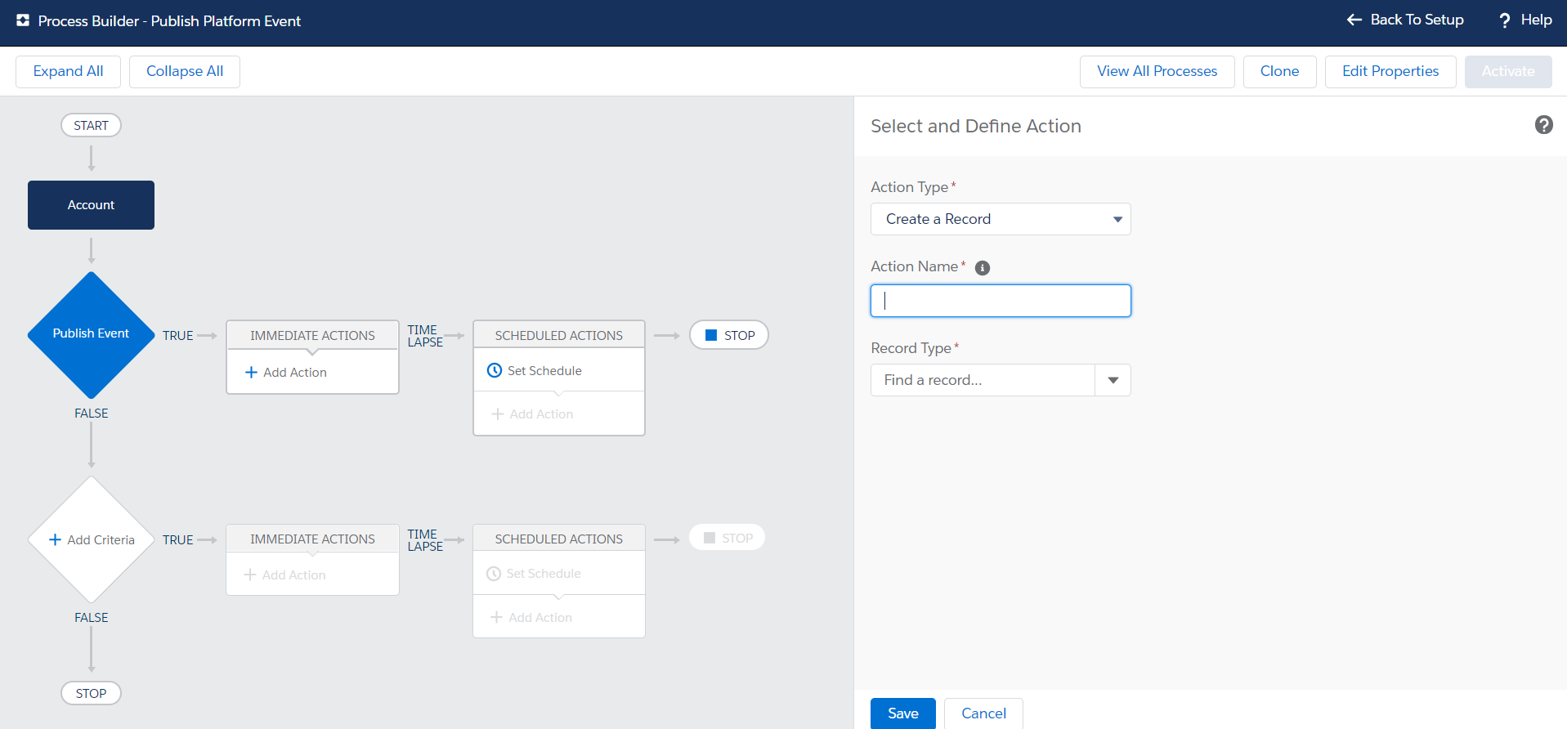
Publish & Subscribe Platform Event with Process Builder

Slide 117
Use Case
When an Account record is created then publish the platform using Process Builder.
When Platform Event is published then subscribe using Process Builder.
Update the account description with some static text and also do a chatter post.

Slide 118
Publish Event using Salesforce API
Login to workbench
Go to Utilities -> Rest Explorer
Create The record of Test Event using Post Method
Sample Request Body
{
“Name__c” : “Sample Event to Process”,
“Account_Id__c” : “”
}

Slide 119
Subscribe PE using Lightning Aura Component
To Subscribe the Platform event using Aura Component we need to use empApi and empApi have inbuilt methods to subscribe and unsubscribe the Event.
<lightning:empApi aura:id="empApi" />
empApi.subscribe(channel, replayId, $A.getCallback(eventReceived => {
console.log('Received event ', JSON.stringify(eventReceived));
}))
empApi.unsubscribe(subscription, $A.getCallback(unsubscribed => {
console.log('Unsubscribed from channel '+ unsubscribed.subscription);
}));

Slide 120
Steps
Use <lightning:empApi aura:id="empApi" /> in your component
Find your empApi in JavaScript using component.find(“AuraId Here”);
On the Button Click Call Subscribe and UnSunscribe method.

Slide 121
Subscribe Standard Platform Event using Aura Component (BatchApexErrorEvent)
Subscribe BatchApexErrorEvent
Create a batch Apex and Throw the error
Use the component from previous lecture to subscribe the Event
Display the data in tabular form in the component

Slide 122
Subscribe Standard Platform Event using Trigger (LogoutEventStream)
Subscribe LogoutEventStream
Enable LogoutEventStream from setup
Create a Custom Object to Store the Event Details
Create an Apex Trigger to Subscribe the Event
Test the Event using both Trigger and Aura Component

Slide 123
Subscribe Platform Event using Node.js
const jsforce = require('jsforce');
const username = 'amitsingh@integration.org';
const password = 'Udemy@2020';
const conn = new jsforce.Connection();
conn.login(username, password, function(err, res) {
if (err) {
return console.error(err);
}
console.log('Authenticated ', res);
conn.streaming.topic("/event/BatchApexErrorEvent").subscribe(function(message) {
console.log('Event Type : ' + message.event.type);
console.log('Event Created : ' + message.event.createdDate);
console.log('Object Id : ' + message.sobject.Id);
console.log('Event : ' + JSON.stringify(message));
});
});

Slide 124
Assignment
Create a Platform Event and Name it “Opportunity Notification”
This platform Event will have the following fields
Name
Stage
Close Date
Amount
Create a Process Builder which will Publish the Event with the above details if the Opportunity is Closed Won.
Create a LWC Component which will subscribe the Event and display the records in a table form.
Create a js file using Node.js and subscribe the same event published using Process Builder

Slide 125
Introduction to Change Data Capture
Change Data Capture is a streaming product on the Lightning Platform that enables you to efficiently integrate your Salesforce data with external systems.
With Change Data Capture, you can receive changes of Salesforce records in near-real time and synchronize corresponding records in an external data store.
CDC uses event driven architecture
CDC only used for record level changes
CDC respects the field level security of your Salesforce Object

Slide 126

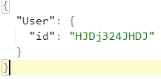

Data Synchronization with Change Data Capture
Event Bus
Change Event
Subscribers
External DB
Salesforce

Slide 127
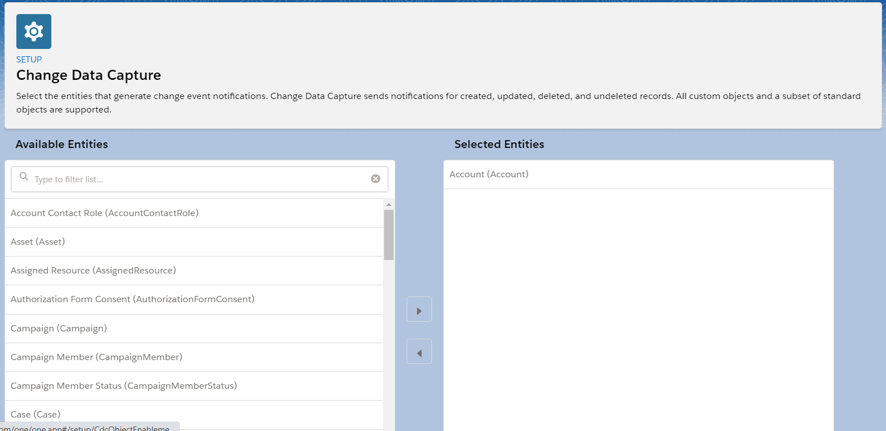
Enable Change Data Capture
Login to Salesforce Org
Navigate to Setup -> Change Data Capture

Slide 128
Subscribe Change Data Capture Using Node.js
conn.streaming.topic("/data/AccountChangeEvent").subscribe(function(message) {
console.log('Event Batch Apex : ', message );
console.log(' \n ' );
});

Slide 129
Prepare Subscription Channel
For Standard Object /data/<ObjectAPIName>ChangeEvent
For All Custom Object /data/<ObjectName>__ChangeEvent
Note :- We need to exclude __c from the Custom object API Name. For example the object API Name is Invoice_Line__c then channel will be Invoice_Line__ChangeEvent

Slide 130
Assignment
Create a Custom Object called Employ with the following attribute
Name ( standard field )
Email
Phone
Enable the Change Data Capture
Create Lightning Web component and subscribe the change data capture for the custom object.

Slide 131
Outbound Message
Outbound message allows you to send the data to external service without writing any web service in a secure way.
Outbound messaging uses the notifications() call to send SOAP messages over HTTP(S) to a designated endpoint when triggered by a workflow rule.
Outbound Message uses SOAP message i.e. XML format
Outbound Message expects a valid Acknowledge from the 3rd party System
Outbound Message has retry mechanism if the message is not acknowledged or failed to send up to 24 Hours
Outbound message can only send the record level information to external system.

Slide 132


Webservice Endpoint
Optional callback using Partner/Enterprise URL, Session Id contained in the original Outbound message
Up-to 100 notifications per SOAP Message
SOAP response
acknowledgement
Workflow rule Trigger
SFDC
SOAP API in Salesforce

Slide 133
Example
There are 2 system Salesforce and a Database to store the Leads. Whenever a lead is coming into salesforce it must need to go to external Database.
If there is any duplicate lead going to External Database then Database will tell Salesforce that this is duplicate lead and please mark this as duplicate lead.

Slide 134
Notification Acknowledgement
Salesforce only consider an outbound message success only if salesforce gets the expected response.
<soapenv:Envelope xmlns:soapenv="http://schemas.xmlsoap.org/soap/envelope/" xmlns:out="http://soap.sforce.com/2005/09/outbound">
<soapenv:Header/>
<soapenv:Body>
<out:notificationsResponse>
<out:Ack>true</out:Ack>
</out:notificationsResponse>
</soapenv:Body>
</soapenv:Envelope>

Slide 135
Outbound in Action
Use Case – Send the Opportunity Details to a particular external system when an Opportunity is closed Won using Outbound Message.
Step 1 – Create a Listener for outbound message.
Step 2 – Create an outbound message for Opportunity Object
Step 3 – Create a Workflow rule to execute that outbound message

Slide 136
External Services
External Services smooths the way for this exchange by letting you declaratively (no coding!) integrate with externally hosted services that perform a variety of business actions or computations for use in your Salesforce org.

Slide 137

Metadata API
Metadata APIs are used to work with Salesforce Metadata.
The Metadata which we can not create/update/delete using Apex can be easily done using Metadata API.
Use Metadata API to retrieve, deploy, create, update or delete customization information, such as custom object definitions and page layouts, for your organization.

Slide 138
What we have included in this Course
List Metadata Using API for example, profile List.
Read Single metadata to get all the details
Create object Using Metadata API.
Create Fields using Metadata API.
Update Field level Security
Delete Metadata Using Metadata API
Create VF Page Using Metadata API
Deactivate Validation Rule / WFR using Metadata API
Delete Custom Metadata Record Using Metadata API.

Slide 139
Setup Metadata class in your Salesforce Org.
Create an Apex Class and name it “MetadataService”
Download the MetadataService Class from “here”
Copy and paste the code into your apex class.

Slide 140
Scenario 1 - List all the profiles
Scenario - We need to get all the details about the profiles that are available in salesforce org.
Solution – We can use SOQL query to get the Profile Details
If we use SOQL Query to fetch the details then we do not see the actual name of our profile. It always displays the Label of the profile
We need to use Metadata API to fetch All the details.
Setup the connection
MetadataService.MetadataPort service = new MetadataService.MetadataPort();
service.SessionHeader = new MetadataService.SessionHeader_element();
service.SessionHeader.sessionId = UserInfo.getSessionId();
Prepare Query
MetadataService.ListMetadataQuery profile = new MetadataService.ListMetadataQuery();
profile.type_x = typex; // Profile, CustomObject, ApexTrigger, ApexClass
Execute Query - service.listMetadata(queries, 25);

Slide 141
Scenario 2 - Read Single Metadata
Read Profile Details
Read ApexClass
Read AuraComponent
Scenario – List all the CustomObject in the dropdown in a vf page and upon selecting any custom object display that object details
MetadataService.Profile profileDetails = (MetadataService.Profile) service.readMetadata('Profile',
new String[] { 'Admin' }).getRecords()[0];

Slide 142
Scenario 3 - Create object using Metadata API
What all it takes to create a custom object
Label of the Object
API Name
Deployment status
Allow Search
Allow Report
Enable History
Sharing Model - Private, Read, ReadWrite, ReadWriteTransfer, FullAccess, ControlledByParent, ControlledByCampaign, ControlledByLeadOrContact
etc

Slide 143
Sample Code…
MetadataService.MetadataPort service = createService();
MetadataService.CustomObject customObject = new MetadataService.CustomObject();
customObject.fullName = objectLabel.replace(' ', '_')+'__c';
customObject.label = objectLabel;
customObject.pluralLabel = pluralLabel;
customObject.nameField = new MetadataService.CustomField();
customObject.nameField.type_x = 'Text';
customObject.nameField.label = objectLabel+' Record';
customObject.deploymentStatus = 'Deployed';
customObject.sharingModel = 'ReadWrite';
List<MetadataService.SaveResult> results = service.createMetadata( new MetadataService.Metadata[] { customObject } );
handleSaveResults(results[0]);

Slide 144
#4 - Create Fields using Metadata API
Create a Text Field
Create External Id Field
Example – You are working as a developer for a company which needs to publish the AppExchange Package. The requirement is to create a Custom Field on the selected object from the UI.
MetadataService.CustomField customField = new MetadataService.CustomField();
customField.fullName = 'Account.TestField__c';
customField.label = 'TestField';
customField.type_x = 'Text';
customField.description = 'This is the field created from Custom Metadata';
customField.inlineHelpText = 'This is the field created from Custom Metadata';
customField.length = 255;

Slide 145
#4.2 Create Fields using Metadata API
Create Lookup/Master Detail Field using MD API
MetadataService.CustomField customField = new MetadataService.CustomField();
customField.fullName = 'Account.LookupField__c';
customField.label = 'Lookup Field';
customField.type_x = 'Lookup';
customField.description = 'This is the lookup field';
customField.inlineHelpText = 'This is the lookup field’;
customField.relationshipLabel = 'Tests';
customField.relationshipName = 'Tests';
customField.referenceTo = 'Contact';

Slide 146
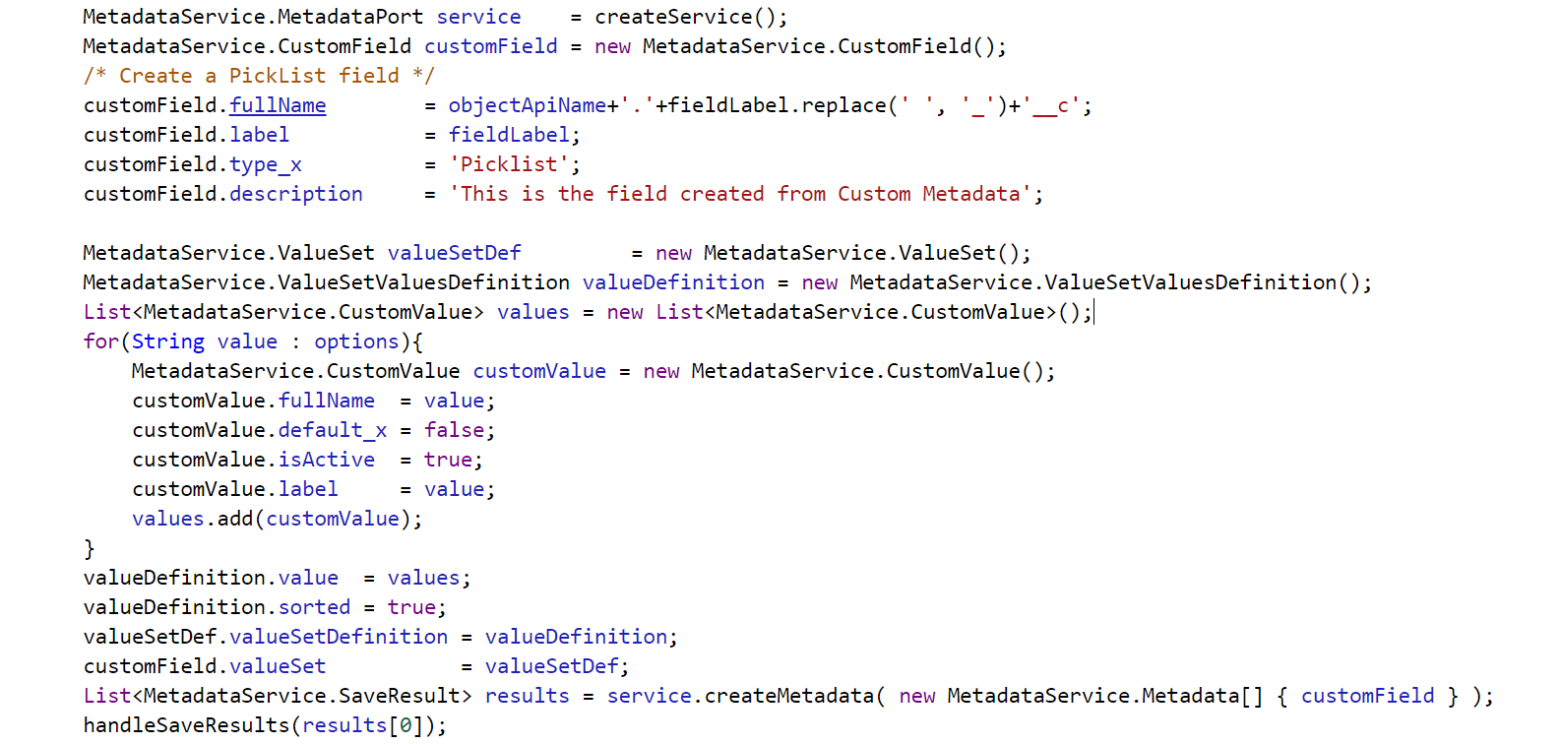
#4.3 Create Fields using Metadata API
Create Picklist field using MD API
Error : Web service callout failed: Unable to find apex schema info

Slide 147
public virtual class CustomValue extends Metadata {
public String color;
public Boolean default_x;
public String fullName;
private String[] fullName_type_info = new String[]{'fullName',SOAP_M_URI,null,'0','1','false'};
public String description;
public Boolean isActive;
public String label;
private String[] color_type_info = new String[]{'color',SOAP_M_URI,null,'0','1','false'};
private String[] default_x_type_info = new String[]{'default',SOAP_M_URI,null,'1','1','false'};
private String[] description_type_info = new String[]{'description',SOAP_M_URI,null,'0','1','false'};
private String[] isActive_type_info = new String[]{'isActive',SOAP_M_URI,null,'0','1','false'};
private String[] label_type_info = new String[]{'label',SOAP_M_URI,null,'0','1','false'};
private String[] apex_schema_type_info = new String[]{SOAP_M_URI,'true','false'};
private String[] field_order_type_info = new String[]{'fullName','color','default_x','description','isActive','label'};
}

Slide 148
Update Field Level Security using API
Update the field level security using Profile
Update the field Level security using Permission Set.
Example – As a Developer you have created the fields now in the backend you need to give the permission to Admin profile and selected permission set which is part of managed package.

Slide 149
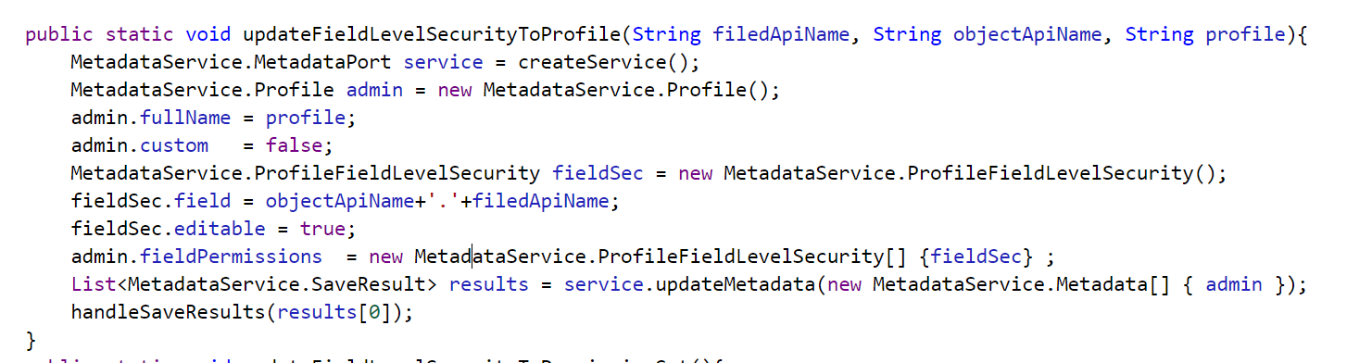
Update Field Level Security using API

Slide 150
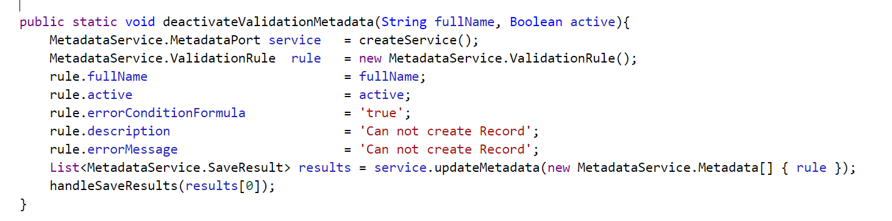
Deactivate Validation Rule using API
Create a Validation Rule on Account Object
Deactivate the same validation rule using MD API.

Slide 151
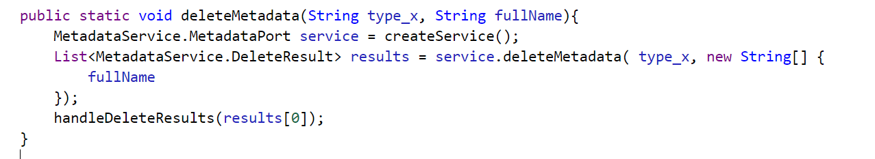
Delete Any Metadata using Metadata API
Create a Validation Rule on Account Object
Delete the same validation rule using MD API.

Slide 152
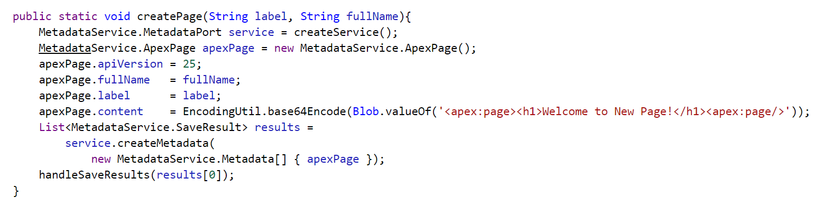
Create a VF Page using Metadata API

Slide 153
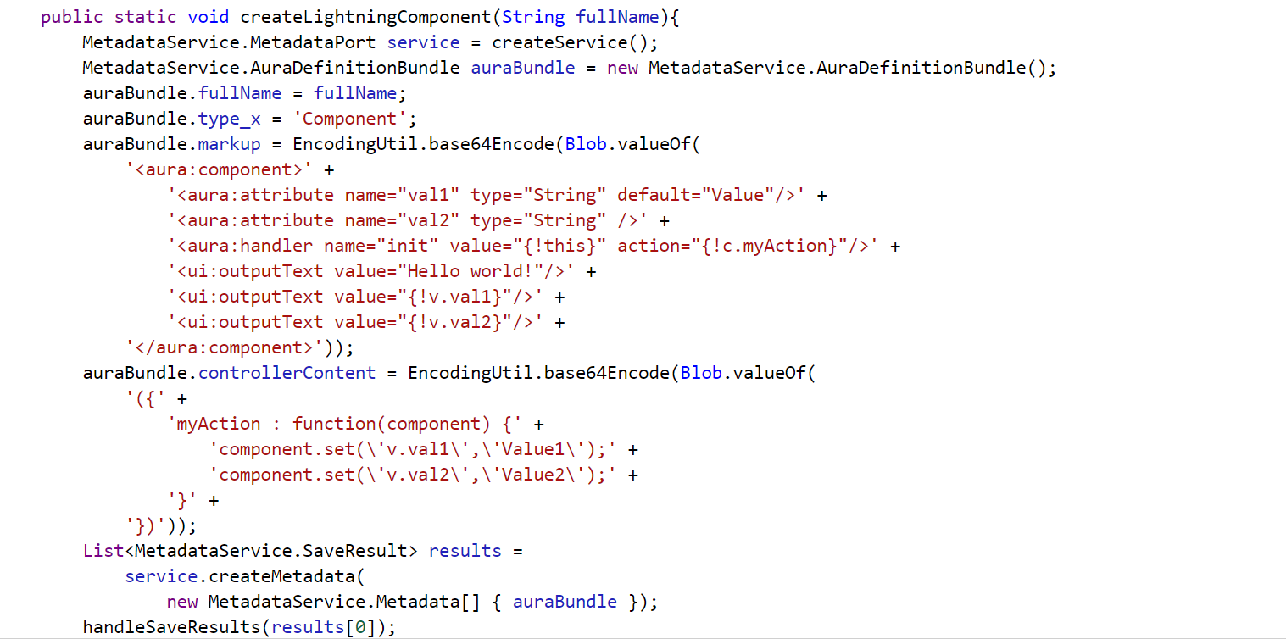
Create an Aura Component using Metadata API

Slide 154
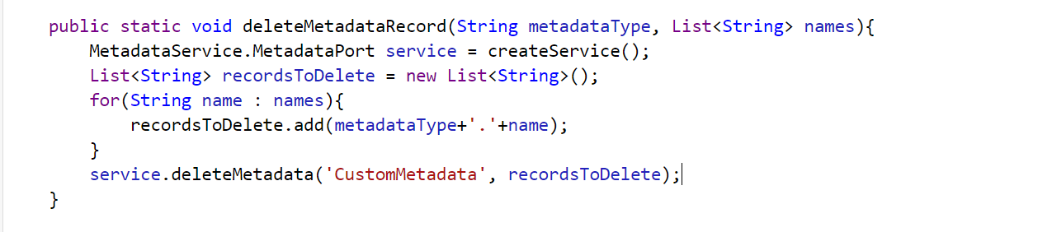
Delete Custom Metadata Record Using MD API

Slide 155
Add a field into Page Layout
Scenario – As a Developer, You have created the field, provided the permission and now you need to add the same field into the page layout.

Slide 156
Assignments
Use listMetadata Record to list all the Custom Object ( Only those who are ending with __c ) and display them in picklist field inside a LWC.
When Use Select any object use readMetadata method to get the information about the object and display basic object information along with fields and validation rules.
Once the object information is displayed there should be a button “New Custom Field” and when user click on that button it should open a new interface where use can enter field information. Clicking on Save button should create a field inside the selected object.
There should be a new button “New Custom Object”, when user click on that button it should open a new interface where use can enter object information. Clicking on Save button should create a an object.

Slide 157
Why we write unit test cases
As a developer, you write code. We write unit test to prove that our software works.
The platform requires at-least 75% over all code coverage to get into production
3 Others good Reasons why we write unit test
Number != lies => Numbers do not lie. Directly affects the cost of the project.
Working Solutions Aren’t Good Enough. Design, Implement, test
Collective Testing

Slide 158
Number != lie
In a 2010 paper on the relative cost of fixing bugs, IBM analysts discuss how long it takes to fix a bug at various times in the software development lifecycle
Their findings are clear:
A bug found during the design phase had a relative cost of 1 hour.
During the implementation (or active development) phase, fixing the same bug had a relative cost of 6.5 hours.
During functional testing, the bug had a relative cost to fix that jumped to 15 hours. A relative cost of 6.5 or even 15 hours is manageable
But the real concern is the relative cost to fix that same bug in production. There, the relative cost to fix it skyrockets to 100 hours.

Slide 159
What are Mock Classes & Why to use them
Be default we can not make HTTP Callout from Test class.
Mock classes are the salesforce Apex Class that we develop using some standard Salesforce Interface to generate the Fake response.
Fake response is used for API Callout so that we do not hit the third party system while doing the testing.
HttpCalloutMock used for testing Rest Services
WebServiceCalloutMock used for testing SOAP Services
We use setMock method of test class to set the fake response

Slide 160
Develop your first class for API Callout
global class YourHttpCalloutMockImpl implements HttpCalloutMock {
global HTTPResponse respond(HTTPRequest req) {
// Create a fake response.
// Set response values, and
// return response.
}
}

Slide 161
Test Multiple/Chained Callout using Single Class
Example – You are making a callout to a payment gateway system to get the following details which are dependent
Get the customer detail
Get all Invoices related to customer
Get All Invoice Line Items related to Invoices

Slide 162
Test SOAP Callout using Apex
WebServiceMock
doInvoke(stub, soapRequest, responseMap, endpoint, soapAction, requestName, responseNamespace, responseName, responseType)

Slide 163
External Objects in Salesforce
External objects are similar to custom objects, except that they map to data that’s stored outside your Salesforce org.
Each org can have up to 100 external objects. External objects don’t count toward the amount for custom objects.
Each external object definition maps to a data table on the external system.
Each of the external object’s fields maps to a table column on the external system.
External objects enable your users and the Lightning Platform to search and interact with the external data.

Slide 164
Cross-Org Adapter for Salesforce Connect
Use cross-org adapter to Collaborate more effectively and improve processes by connecting the data across your Salesforce orgs.
Suppose that you store your inventory of products in one Salesforce org. You want your regional and local branch offices, who have their own orgs, to see the latest information about your stock.

Slide 165
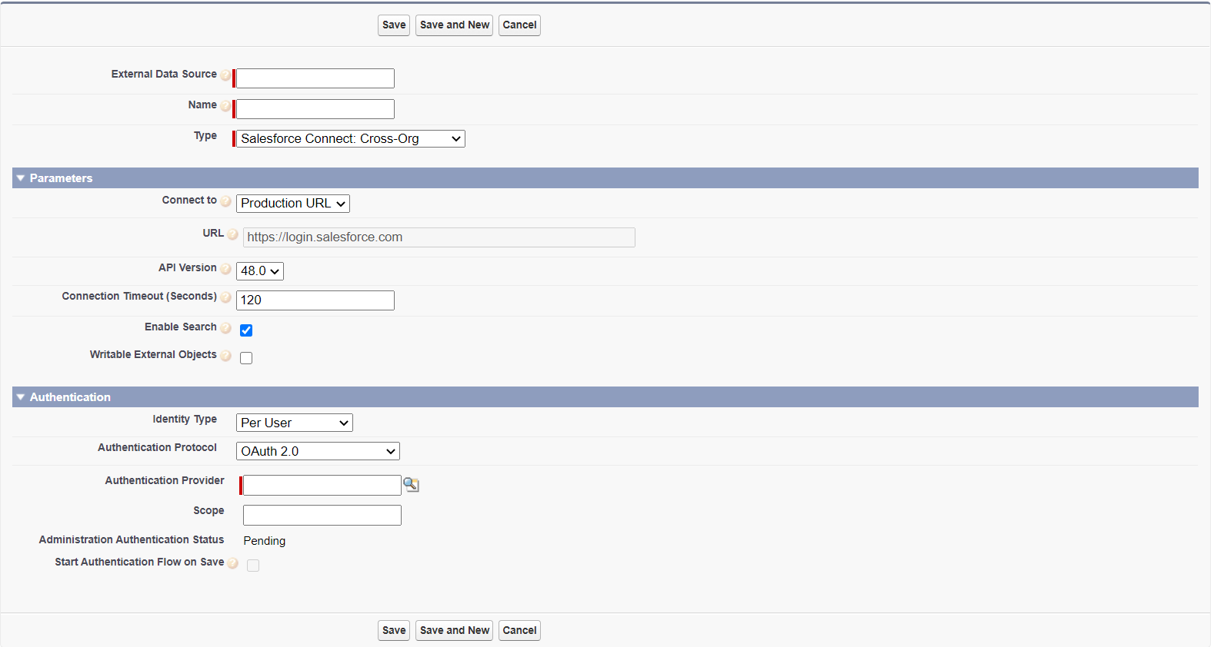

Slide 166

Introduction to Heroku
Heroku is a container-based cloud Platform as a Service (PaaS). Developers use Heroku to deploy, manage, and scale modern apps. Platform is elegant, flexible, and easy to use, offering developers the simplest path to getting their apps to market.
Using Heroku you can develop application in any language and run on cloud.
Ruby
Java
Php
Python
Go
Scala
Clojure
etc

Slide 167
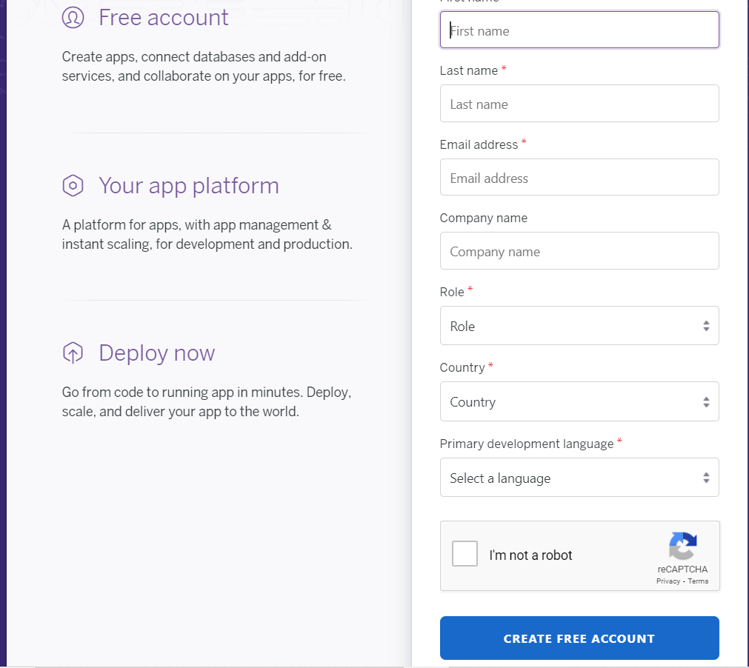
Signup for Heroku Account

Slide 168
Salesforce Heroku Integration
A number of methods to accomplish these types of integrations are available, including:
Heroku Connect
Salesforce Connect
Salesforce REST APIs
Callouts
Canvas
MuleSoft
Outbound Messages

Slide 169
Heroku Connect
Heroku Connect makes it easy for you to build Heroku apps that share data with your Salesforce deployment.
Using bi-directional synchronization between Salesforce and Heroku Postgres, Heroku Connect unifies the data in your Postgres database with the contacts, accounts and other custom objects in the Salesforce database.
Easily configured with a point and click UI, it’s simple to get the service up and running in minutes – no coding or complex configuration is required.

Slide 170
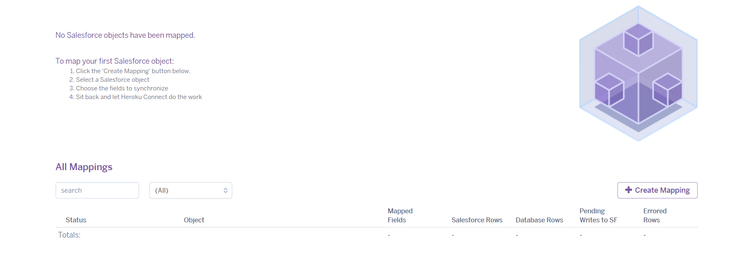
Setup Heroku Postgress Database

Slide 171

Project – Integration with Salesforce

Slide 172
Objects to Integrate
User
Currencies
Stages
Organization
Person
Lead
Deals
Activities

Slide 173
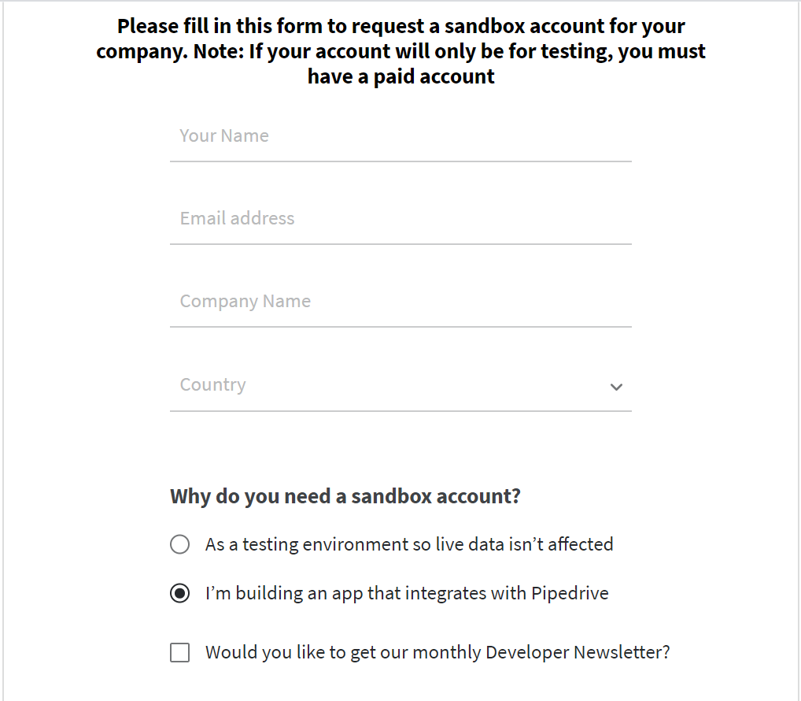
Setup Pipedrive Account
https://developers.pipedrive.com/start-here

Slide 174
Object Mapping
Pipedrive Object | Salesforce Object | Description
User | Pipeline_User__c | We do not have that much user license in our developer org
Currencies | Currency__c | To store all the supported currency in salesforce org.
Stages | Stage__c | The stage information for lead and deals
Organization | Account | The organization is an account in salesforce
Person | Contact | The Person in pipedrive is Contact in Salesforce
Lead | Lead
Deal | Opportunity
Activities | Activities

Slide 175
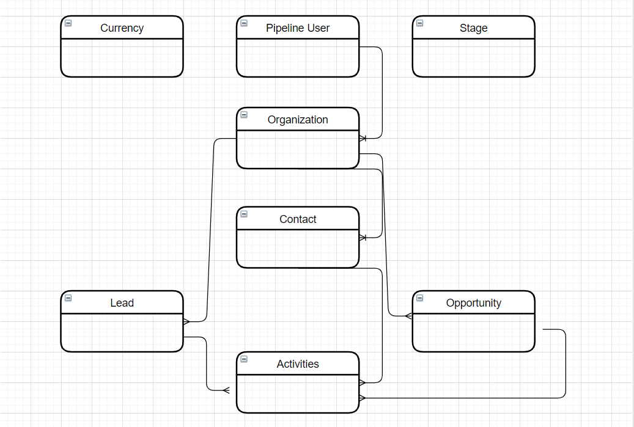
Object Relation Diagram

Slide 176
Pipedrive Authentication
Pipedrive uses API KEY Authentication for all the API Callouts.
the API token must be provided as part of the query string for all requests, using the api_token variable, for example
https://companydomain.pipedrive.com/api/v1/deals/2?api_token=659c9fddb16335e48cc67114694b52074e812e03

Slide 177
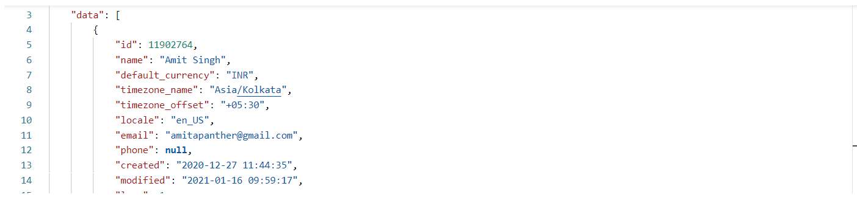
Integrate Pipedrive Users with Salesforce
Develop a Batch Apex to read all the users from Pipedrive and Store into the Custom Salesforce Object. Also, Schedule the same Batch Apex to run everyday at 12:00 AM

Slide 178
Integrate Supported Currency from Pipedrive
Develop a Batch Apex to read all the currencies from Pipedrive and Store into the Custom Salesforce Object. Also, Schedule the same Batch Apex to run everyday at 12:00 AM

Slide 179
Get Deal/Lead Stages from Pipedream and store into Salesforce
Develop a Batch Apex to read all the stage from Pipedrive and Store into the Custom Salesforce Object. Also, Schedule the same Batch Apex to run everyday at 12:00 AM

Slide 180
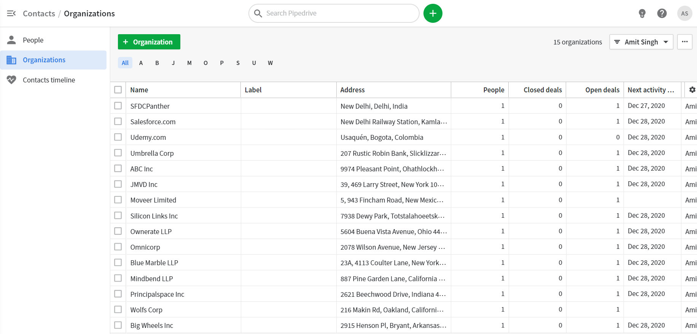
Get Pipedrive Organizations to Salesforce
https://companydomain.pipedrive.com/api/v1/organizations

Slide 181
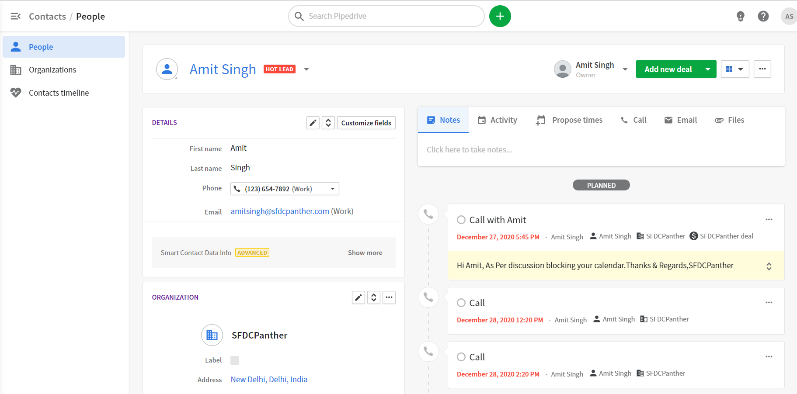
Get Persons from Pipedrive to Salesforce
https://companydomain.pipedrive.com/api/v1/persons

Slide 182
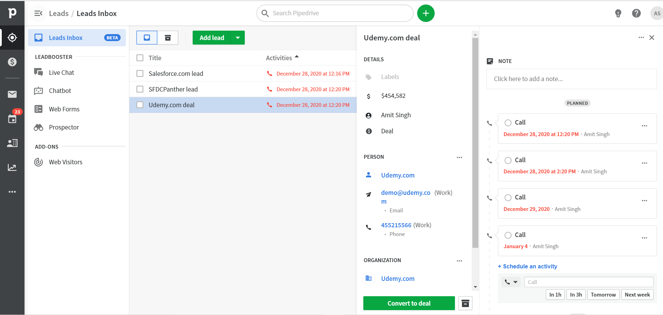
Get Lead from Pipedrive to Salesforce
https://companydomain.pipedrive.com/api/v1/lead

Slide 183
Before we go ahead
Enable Multi Currency if not enabled
Add all the currency that our Deal have in PipeDrive

Slide 184
Final Project Assignment – ActiveCampaign Integration
Account
Address
Campaign
Contact
Account Contact Association
Deals
Task

Slide 185

This is not the end of the course
Yes. You have read it correctly it’s not the end of the course. Below is the list what you can expect in near future
Updates from Salesforce Releases
Tooling API
Integration Patters
New Course on Salesforce + MuleSoft Integration

